Slide 1

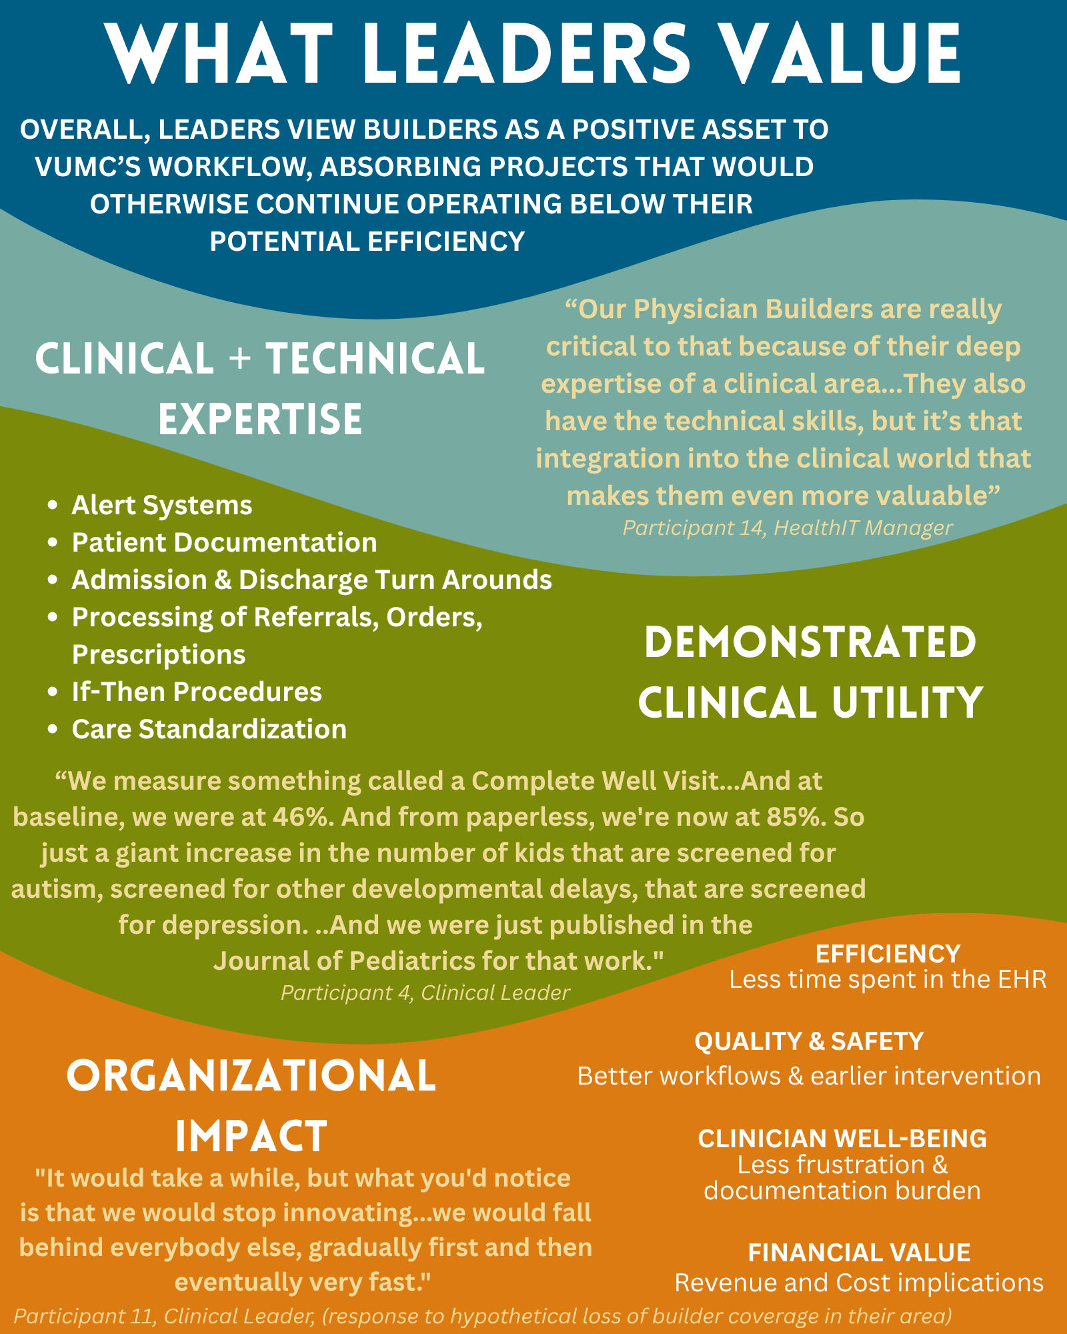
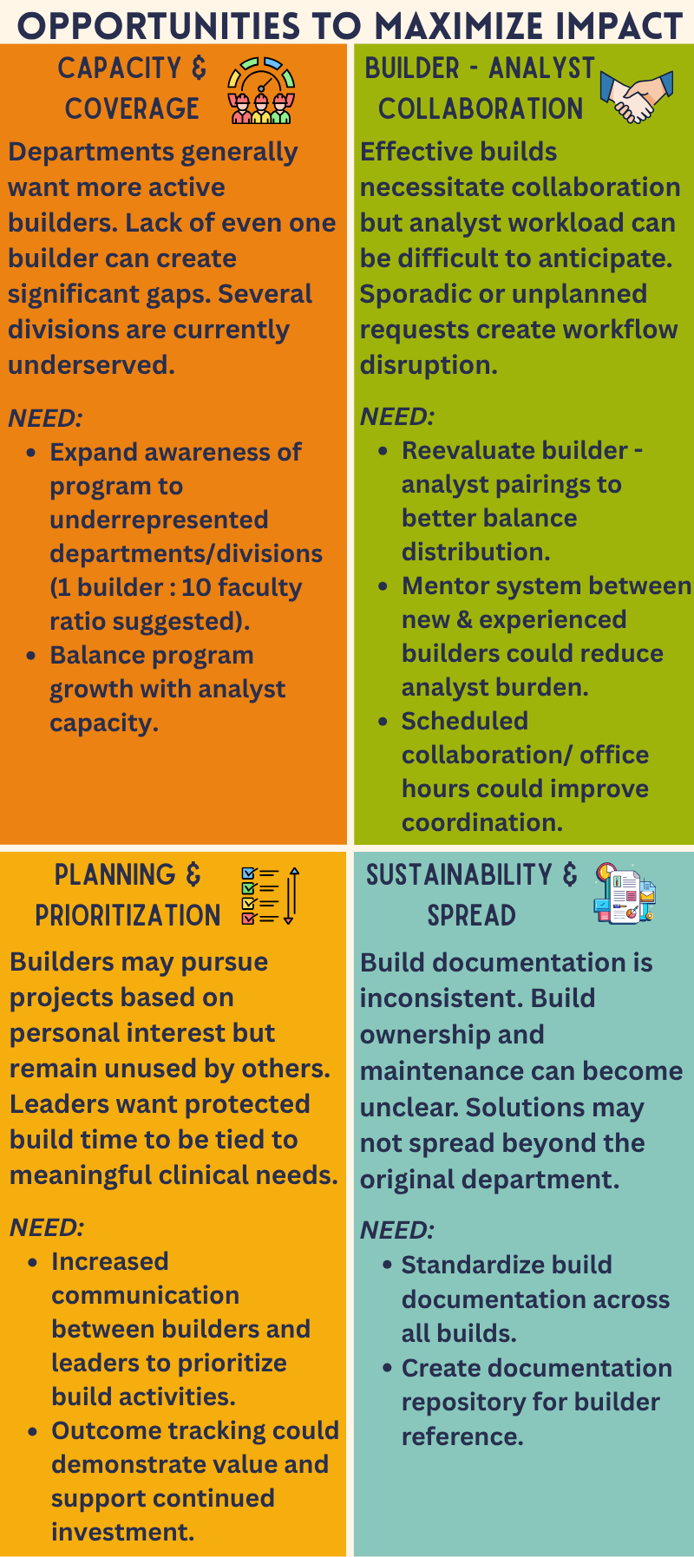



A Qualitative Evaluation of VUMC’s Physician Builder Program: Perspectives from Clinical and HealthIT Leaders
Laura Zahn¹; Mhd Wael Alrifai^{1,2}, Adam Wright^{1,3}, Allison McCoy¹, Jon Wanderer^{1,4}
Department of Biomedical Informatics¹, Pediatrics², Medicine³, Anesthesiology⁴, Vanderbilt University Medical Center
Through the Physician Builder program, trained members can customize and configure our local instance of Epic to improve clinical workflows. VUMC has one of the largest Physician Builder programs, with 116 builders currently.
OBJECTIVE
To understand how clinical and HealthIT leaders perceive the value, challenges, and future needs of VUMC's Physician Builder Program.
METHODS
16 Semi-structured interviews with
12 Clinical Leaders
4 HealthIT Leaders
Interviews explored perceptions of program impact, strengths, challenges, and opportunities for future growth. Interviews and thematic analysis were completed by Vanderbilt’s Qualitative Research Core (QRC).
Presenter:
Laura Zahn
Laura.a.zahn@vumc.org
Notes:
Notes:
In Powerpoint, click View > Guides
Keep text within gutter guides.
Author list: Don’t split names onto two lines (e.g., “Jimmy [break] Smith”). If that happens, use a new line, unless you need the space. Bold the first names of anybody who’s presenting in person.
Intro/methods/result: Do not drop below font size 28, but if you have extra space, jack up the font size until the space is full.
Do not use color in the sidebars except in graphs/figures. It’ll pull attention from the center and slow interpretation for passersby.

