Slide 1


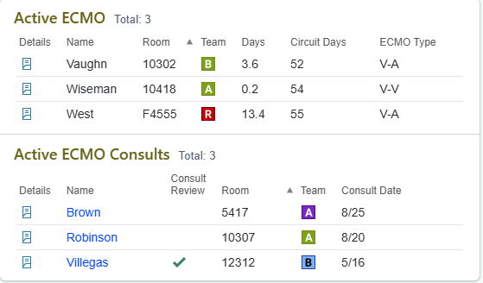


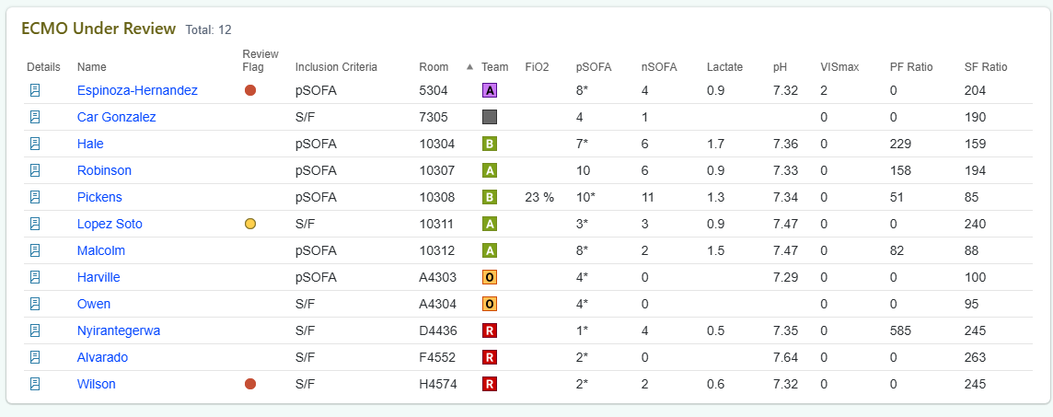







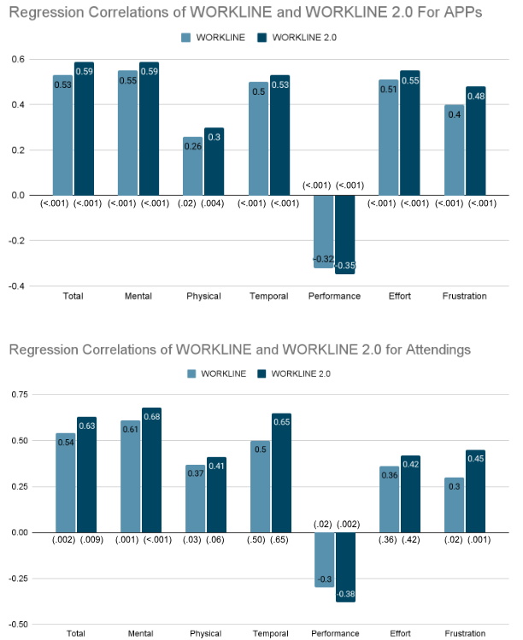
ECMO Real-Time Monitoring: An Interactive eStar Radar Dashboard of Active and At-Risk Patients
Gwendolyn Thompson, MS; Pradeep Mummidi, MS, MMHC; Mary Keith, DO, MS; Wael Alrifai, MD, MS
Peds Analytics of Monroe Carell Jr Children’s Hospital at Vanderbilt
PURPOSE
Creating a single source of truth for ECMO patient tracking, consultation, and early candidate identification
Identifying patients at risk of requiring ECMO through automated clinical screening, enabling earlier review and intervention
COMPONENTS
Active ECMO
Real-time view of all patients currently on ECMO, along with key patient information
ECMO Consults
All patients with an ECMO consult order requiring review, allowing clinicians to evaluate and track consultations in one location
ECMO Under Review
Identifies patients meeting clinical criteria who may benefit from ECMO evaluation, enabling proactive review and early recognition
From real-time identification to active support, the ECMO Dashboard brings the entire ECMO process to one place.
ECMO UNDER REVIEW LOGIC
FiO2> 80% and no flow between 0 and 2 LPM
VISmax > 15
Lactate > 4.9 with 6 hour lookback
PH < 7.2 with 6 hour lookback
pSOFA > 7
nSOFA > 7
S/F <= 264
P/F <= 300
ECMO REVIEW PLAN
Designed to review patients fitting clinical criteria
Exclude: Permanently removed
Alert: Flagged as urgent
Continuous: Flagged for ongoing monitoring
Postpone: Removed from list to reassess at a later date
PLANNED ENHANCEMENTS
OI and OSI to replace S/F and P/F in the criteria
ECMO Movement and ECMO Standby components
Scan for website
Presenter:
Gwendolyn Thompson
gwendolyn.thompson@vumc.org
Notes:
Notes:
In Powerpoint, click View > Guides
Keep text within gutter guides.
Author list: Don’t split names onto two lines (e.g., “Jimmy [break] Smith”). If that happens, use a new line, unless you need the space. Bold the first names of anybody who’s presenting in person.
Intro/methods/result: Do not drop below font size 28, but if you have extra space, jack up the font size until the space is full.
Do not use color in the sidebars except in graphs/figures. It’ll pull attention from the center and slow interpretation for passersby.

