Slide 1
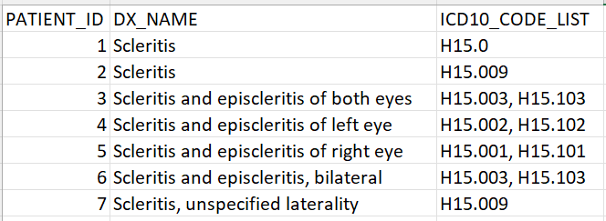
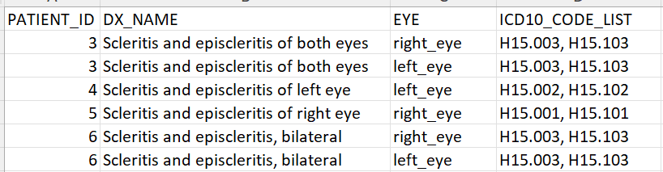






Overcoming Data Challenges for Improved Ophthalmology Research
Donald G. Sengstack, MS, Sapna S. Gangaputra, MD, MPH, Abhiram R. Manda, Allison B. McCoy, PhD, ACHIP, FACMI, FAMIA
¹Department of Biomedical Informatics, ²Vanderbilt Eye Institute
INTRO
Leveraging data to improve healthcare outcomes requires consistent and accurate data. Before a researcher can utilize a data table, they need to understand what each row in the table represents. Careful attention is required for Ophthalmology data because raw data is often stored for each eye rather than for each patient.
METHODS
Drop any unspecific diagnoses
Split diagnoses that apply to both eyes (both, bilateral, etc.) into their own rows
Add column to indicate which eye the row is referencing
Join eye specific test results on the patient encounter id and the specific eye for simplified analysis and consistent granularity
Ophthalmology data presents unique challenges compared to other fields in healthcare research. A combined understanding of domain knowledge and database structure is needed to ensure better research outcomes.
OUTCOMES
With the datasets created, the VCLIC Core Team and the Vanderbilt Eye Institute (VEI) have collaborated to produce 6 publications and presentations in the past year. Areas of published research include travel burden for patients with uveitis, adverse events associated with ocular corticosteroid injections, and more.
Presenter:
Donnie Sengstack
donald.sengstack@vumc.org
Notes:
Notes:
In Powerpoint, click View > Guides
Keep text within gutter guides.
Author list: Don’t split names onto two lines (e.g., “Jimmy [break] Smith”). If that happens, use a new line, unless you need the space. Bold the first names of anybody who’s presenting in person.
Intro/methods/result: Do not drop below font size 28, but if you have extra space, jack up the font size until the space is full.
Do not use color in the sidebars except in graphs/figures. It’ll pull attention from the center and slow interpretation for passersby.

