Slide 1
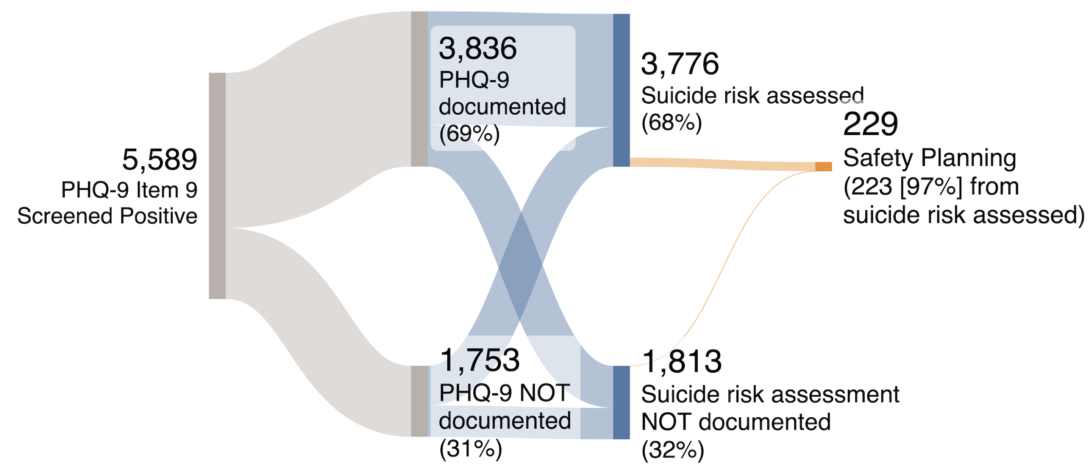
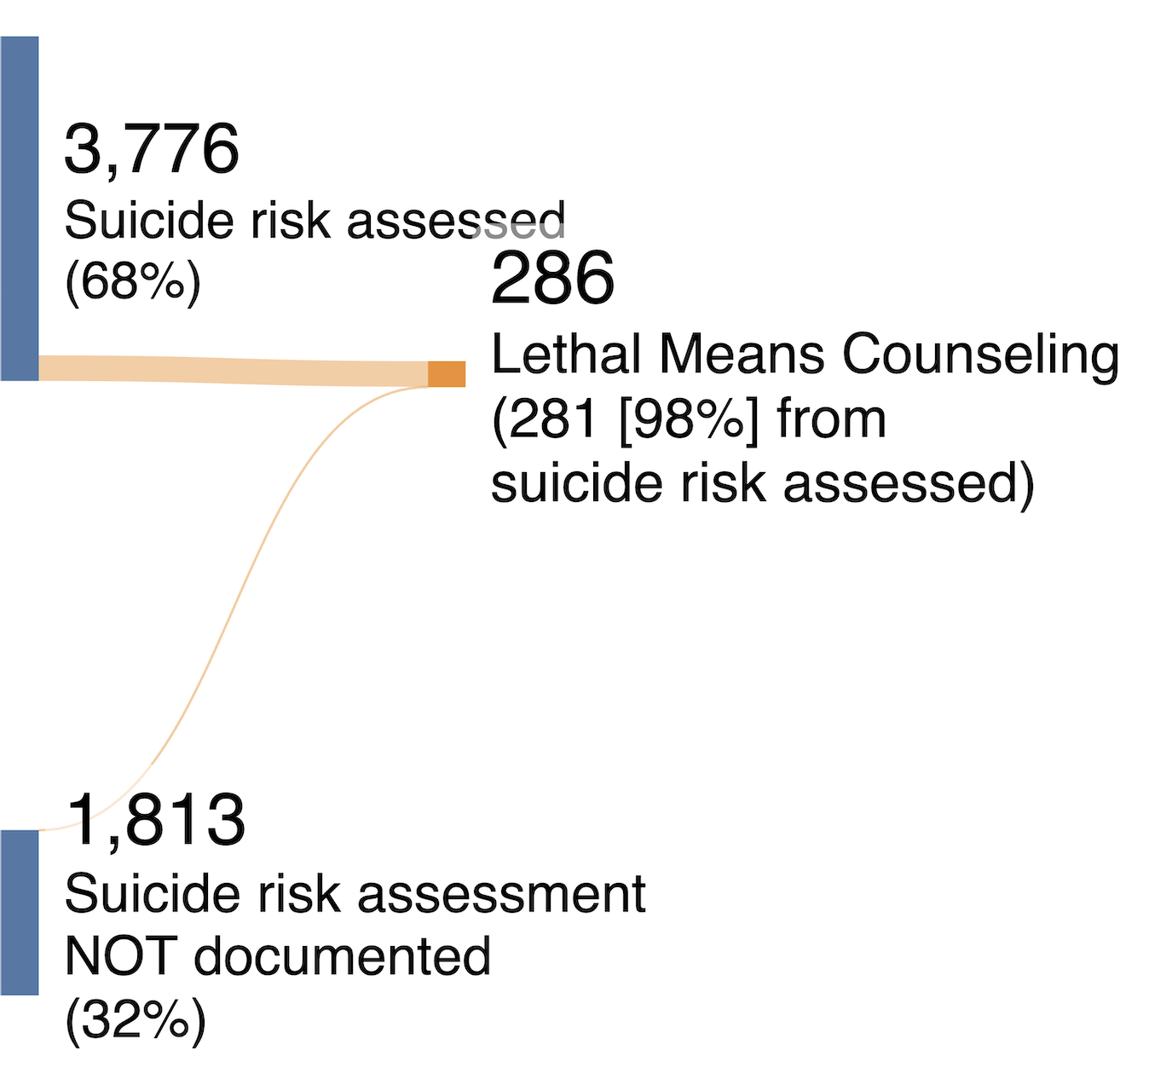
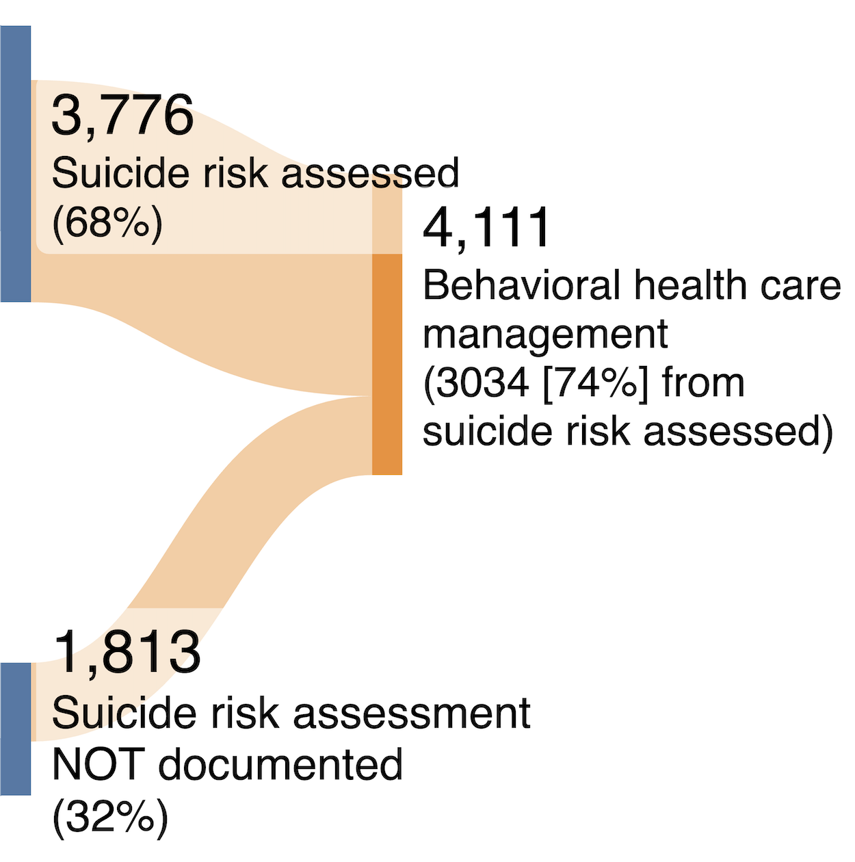



Clinician responses to suicide risk screening in primary care:
Health system-wide observational study using clinical notes
Hyunjoon Lee, MS, Cathy Shyr, PhD, Allison B. McCoy, PhD, Cosmin A. Bejan, PhD, Julian Genkins, MD,
Jessica S. Ancker, PhD, MPH, Adam Wright, PhD, Katherine M. Schafer, PhD*, Colin G. Walsh, MD, MA*
Department of Biomedical Informatics, Vanderbilt University Medical Center
INTRODUCTION
Do primary care physicians respond to positive suicide risk screenings (Patient Health Questionnaire [PHQ-9]) in an evidence-based manner?
Emphasis has been on patient completion rates; measuring clinician responses to patient-completed PHQ-9 is difficult.
Objective: Measure and assess clinician responses to patient-completed PHQ-9 item 9 using large language models (LLMs) applied to clinical notes.
METHODS
We evaluated the performance of LLM-extracted (Qwen3 14B, GPT-4.1 mini, GPT-5.4) clinician responses against 200 manually annotated notes.
Among patients who screened positive
(N =5,589), we examined the proportion of
encounters in which clinicians documented:
PHQ-9 score
Suicide risk assessment
Safety planning
Lethal means counseling
Behavioral health care management
“Note-based assessment of clinician responses to positive suicide risk screenings suggests gaps in evidence-based management of suicidality in primary care.”
RESULTS
F1 and specificity exceeded 0.95 for all LLM-extracted clinician responses.
14% lacked documentation for both PHQ-9 score and suicide risk assessment.
Notes containing no mention of risk assessment were less likely to include safety planning, lethal means counseling, and behavioral health care management than notes indicating that patient was confirmed negative for suicidal ideation.
Attending physicians documented clinician responses less often than nurse practitioners, resident physicians, fellows, and physician assistants.
DISCUSSION
LLM-based measurement offers a new way to measure/assess clinician responses, with further gains expected as Ambient AI scribes mature.
Limitation: Note-based measure may under-capture yet may be the most faithful.
Figure 1. Sankey diagram of documented clinician responses to positive suicide risk screenings.
hyunjoon.lee.1@vumc.org
Notes:
Notes:
In Powerpoint, click View > Guides
Keep text within gutter guides.
Author list: Don’t split names onto two lines (e.g., “Jimmy [break] Smith”). If that happens, use a new line, unless you need the space. Bold the first names of anybody who’s presenting in person.
Intro/methods/result: Do not drop below font size 28, but if you have extra space, jack up the font size until the space is full.
Do not use color in the sidebars except in graphs/figures. It’ll pull attention from the center and slow interpretation for passersby.

