Slide 1
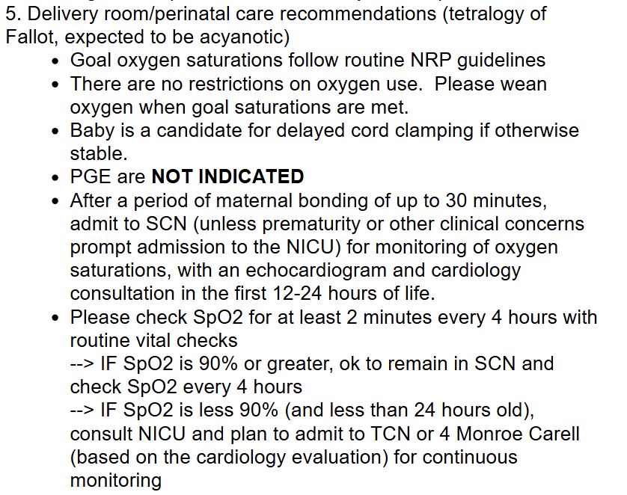
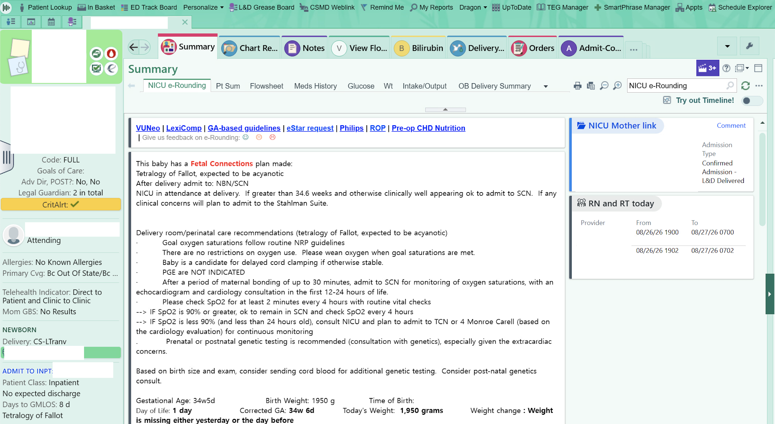





Fetal Connections: Vanderbilt’s Application in the Foundation System Improves Congenital Heart Disease Clinical Practices
Alexander Bruno MD, Emily Morris MD, Allison McCoy PhD, Laura Zahn MS, Wael Alrifai MD
PURPOSE
Infants with congenital heart disease require individualized care in the delivery room
Immediate postnatal measures such as prostaglandin (PGE) administration and delayed cord clamping (DCC) are determined by a fetal cardiologist
The plans for these measures must be available to the resuscitation team at the time of delivery
Previously, neonatologists had to search within the mother's chart and contact fetal providers directly for care plans
INTERVENTION
In 2020, Vanderbilt implemented Fetal Connections, which was then adopted into the Epic Foundation System
Application allows a seamless and highly visible digital handoff of prenatally developed care plans to the resuscitation team
Use of the Fetal Connections application is associated with increased adherence to individualized delivery room care plans in infants with congenital heart disease
METHODS
N = 614 deliveries (422 supported by Fetal Connections)
Reviewed adherence to PGE and DCC care plans
RESULTS
Adherence to PGE administration plans was 84% in the control group and 92% in the intervention group
Adherence to DCC was 18% for the control group and 74% for the intervention group
CONCLUSIONS
Adoption of this program by fetal providers is highly encouraged to streamline communication and improve care in the delivery room
Care plan created prenatally and documented in mother’s chart
Fetal Connections tool transmits care plan to newborn’s chart
Fetal Connections tool improves adherence to care plans
Presenter:
Alexander Bruno
alexander.p.bruno.1@vumc.org
Notes:
Notes:
In Powerpoint, click View > Guides
Keep text within gutter guides.
Author list: Don’t split names onto two lines (e.g., “Jimmy [break] Smith”). If that happens, use a new line, unless you need the space. Bold the first names of anybody who’s presenting in person.
Intro/methods/result: Do not drop below font size 28, but if you have extra space, jack up the font size until the space is full.
Do not use color in the sidebars except in graphs/figures. It’ll pull attention from the center and slow interpretation for passersby.

