Slide 1
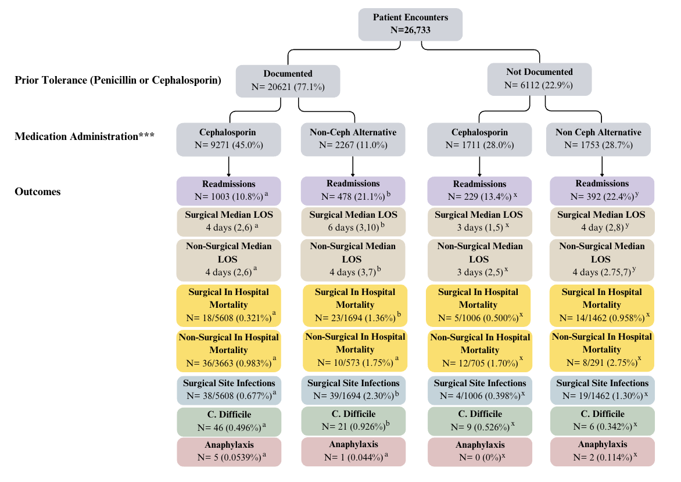
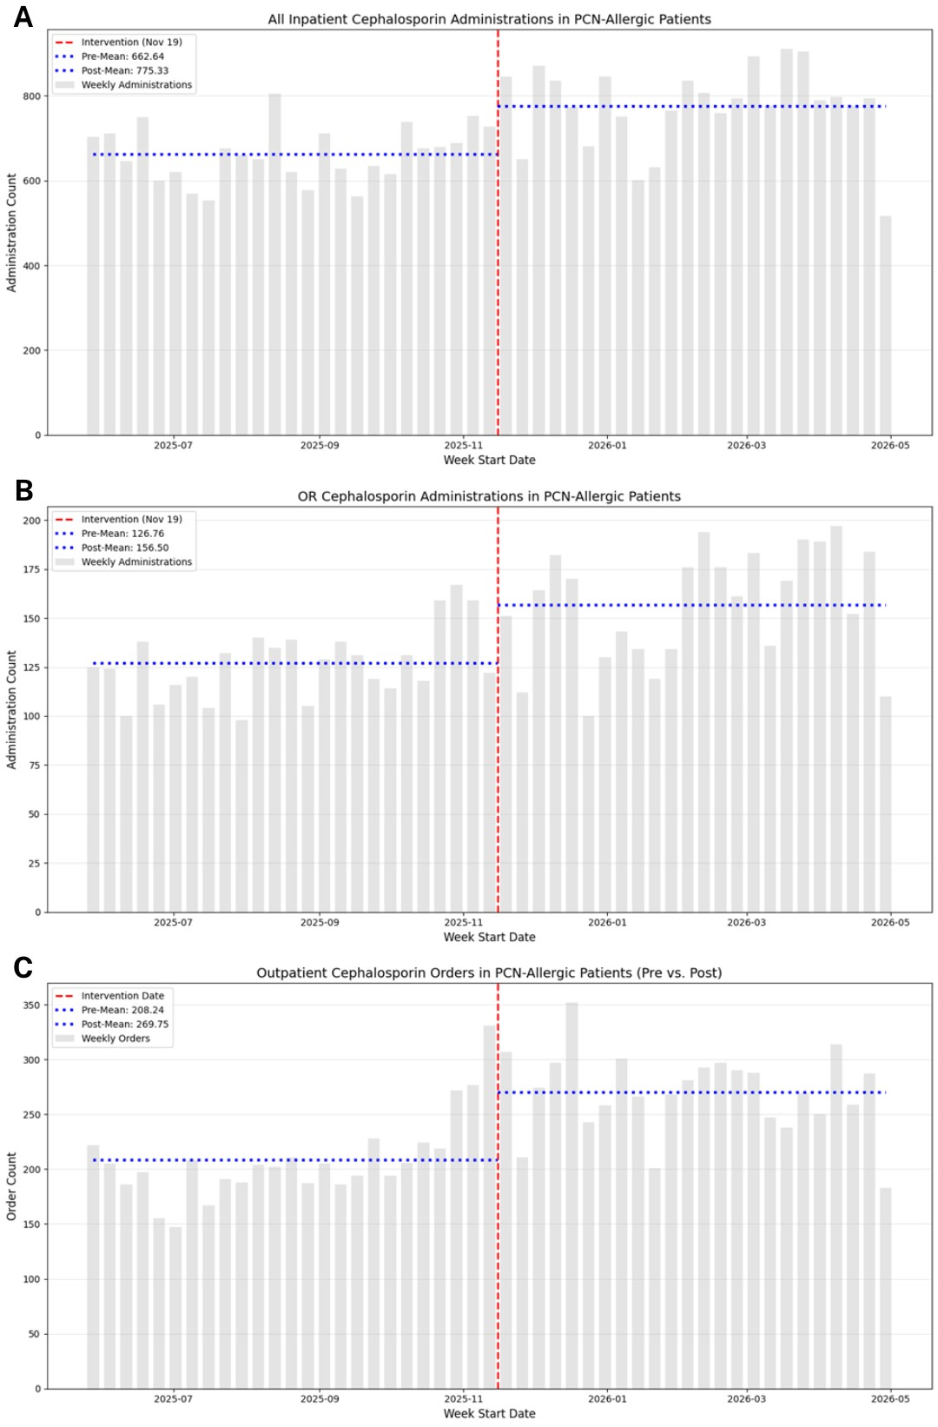
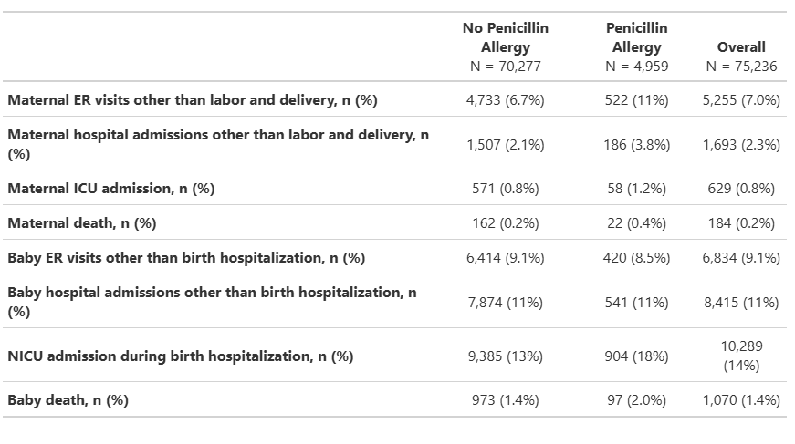

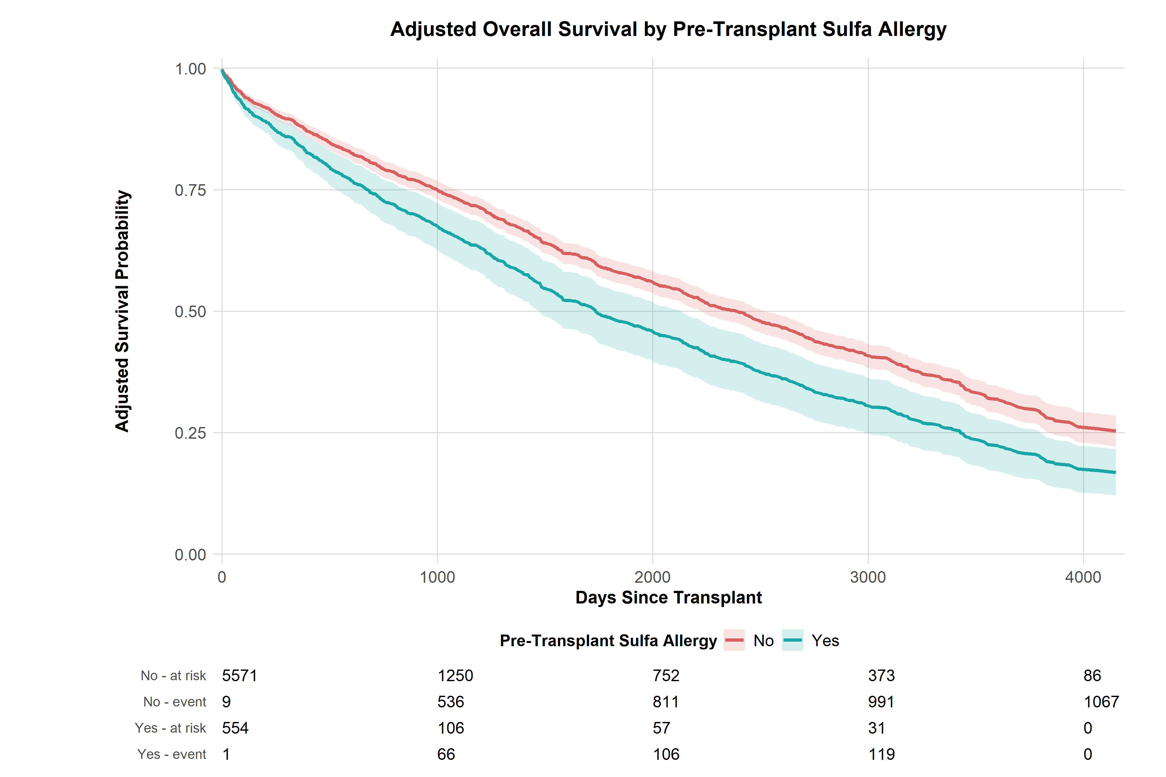

Closing the Quality Gaps in Antibiotic Allergy
Labeled Patients
Cosby Stone, Jr. MD, MPH (on behalf of a giant team)- cosby.a.stone@vumc.org
Division of Allergy/Pulmonary and Critical Care, Vanderbilt University Medical Center
PURPOSE
First line antibiotic allergy labels are highly prevalent and impact clinical decision making.
Assumptions about cross reactivity are largely untrue
Avoidance may lead to worsened outcomes
EHRs may need to be updated to facilitate delabeling and fix cross reactivity.
METHODS
Study 1: Analyzed alert logs, medication orders, and outcomes for inpatients with and without penicillin allergy labels (PALs) who had cephalosporins ordered, or not.
Study 2: Implemented an improved allergy penicillin cephalosporin cross-reactivity alert.
Study 3: epidemiologic retrospective cohort looking at untested penicillin allergy labels in pregnancy.
Study 4: epidemiologic retrospective cohort in solid organ transplant recipients, respectively.
Patients have worse outcomes when untested antibiotic allergies lead to use of a second line antibiotic.
RESULTS:
Study 1: Increased rates of readmission, surgical site infection and longer length of stay when cephalosporins are avoided in PAL patients.
Study 2: Immediate, safe 20-30% increases in first line cephalosporin use with an improved cross-reactivity alert.
Study 3: Higher rates of post-partum admissions and death in moms and babies when mothers have untested penicillin allergy labels. All p<0.05.
Study 4: 39% increased mortality in transplant patients with untested sulfonamide allergy labels, even with adjustment, 1.39 (1.15-1.68, p=0.001).
STUDY 1
STUDY 2
STUDY 3
Conclusions:
Untested antibiotic allergy labels carry risks of worsened outcomes.
EHRs can facilitate stewardship and by improving cross-reactivity alerts.
Proactive programs to facilitate testing and delabeling are crucial.
STUDY 4
Delabeling allergies and fixing cross reactivity alerts can help!
Notes:
Notes:
In Powerpoint, click View > Guides
Keep text within gutter guides.
Author list: Don’t split names onto two lines (e.g., “Jimmy [break] Smith”). If that happens, use a new line, unless you need the space. Bold the first names of anybody who’s presenting in person.
Intro/methods/result: Do not drop below font size 28, but if you have extra space, jack up the font size until the space is full.
Do not use color in the sidebars except in graphs/figures. It’ll pull attention from the center and slow interpretation for passersby.

