Slide 1
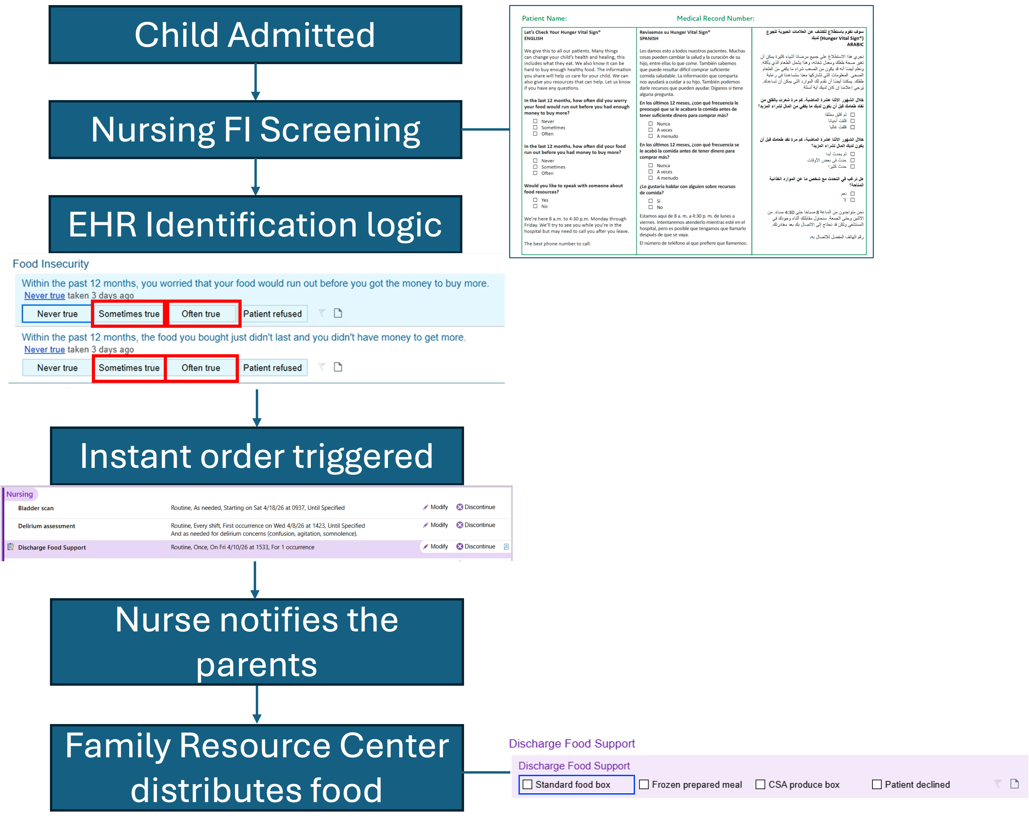
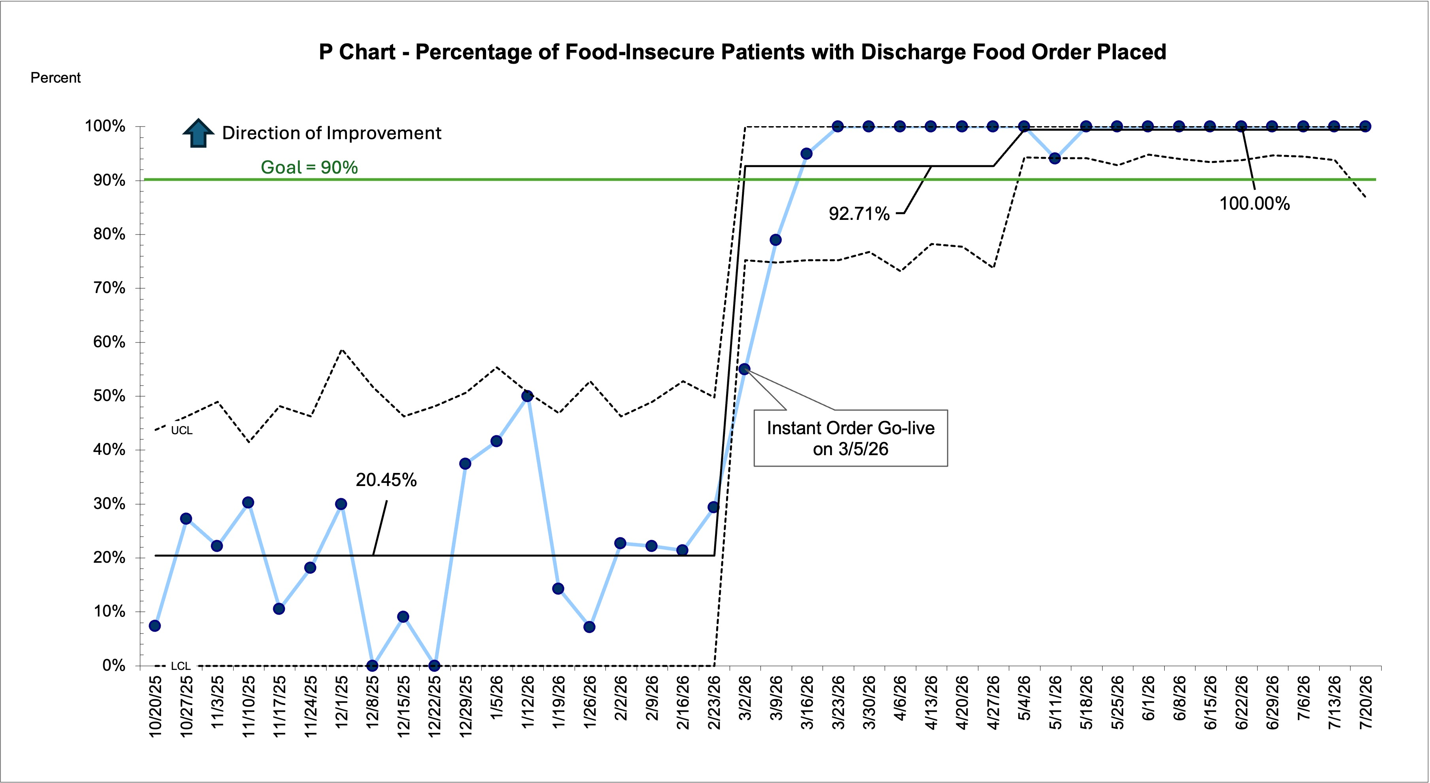
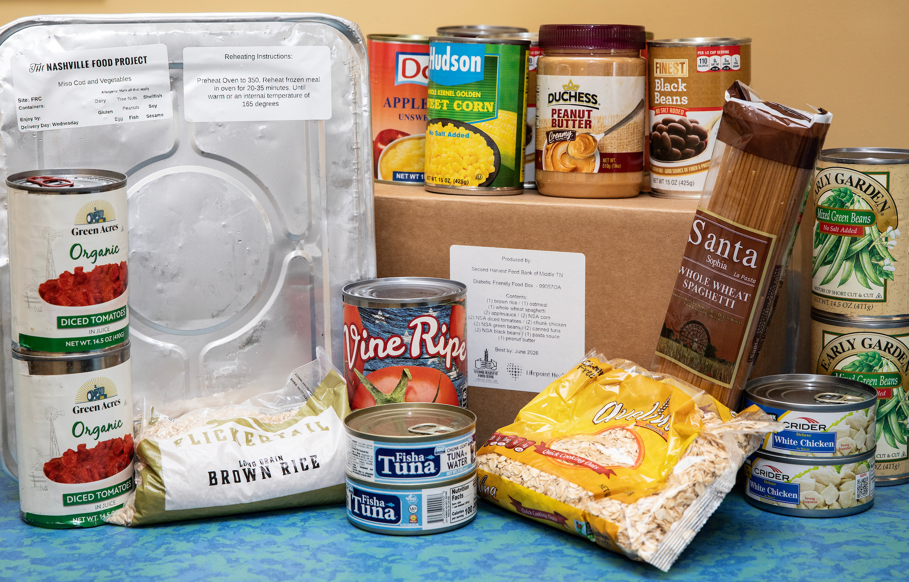
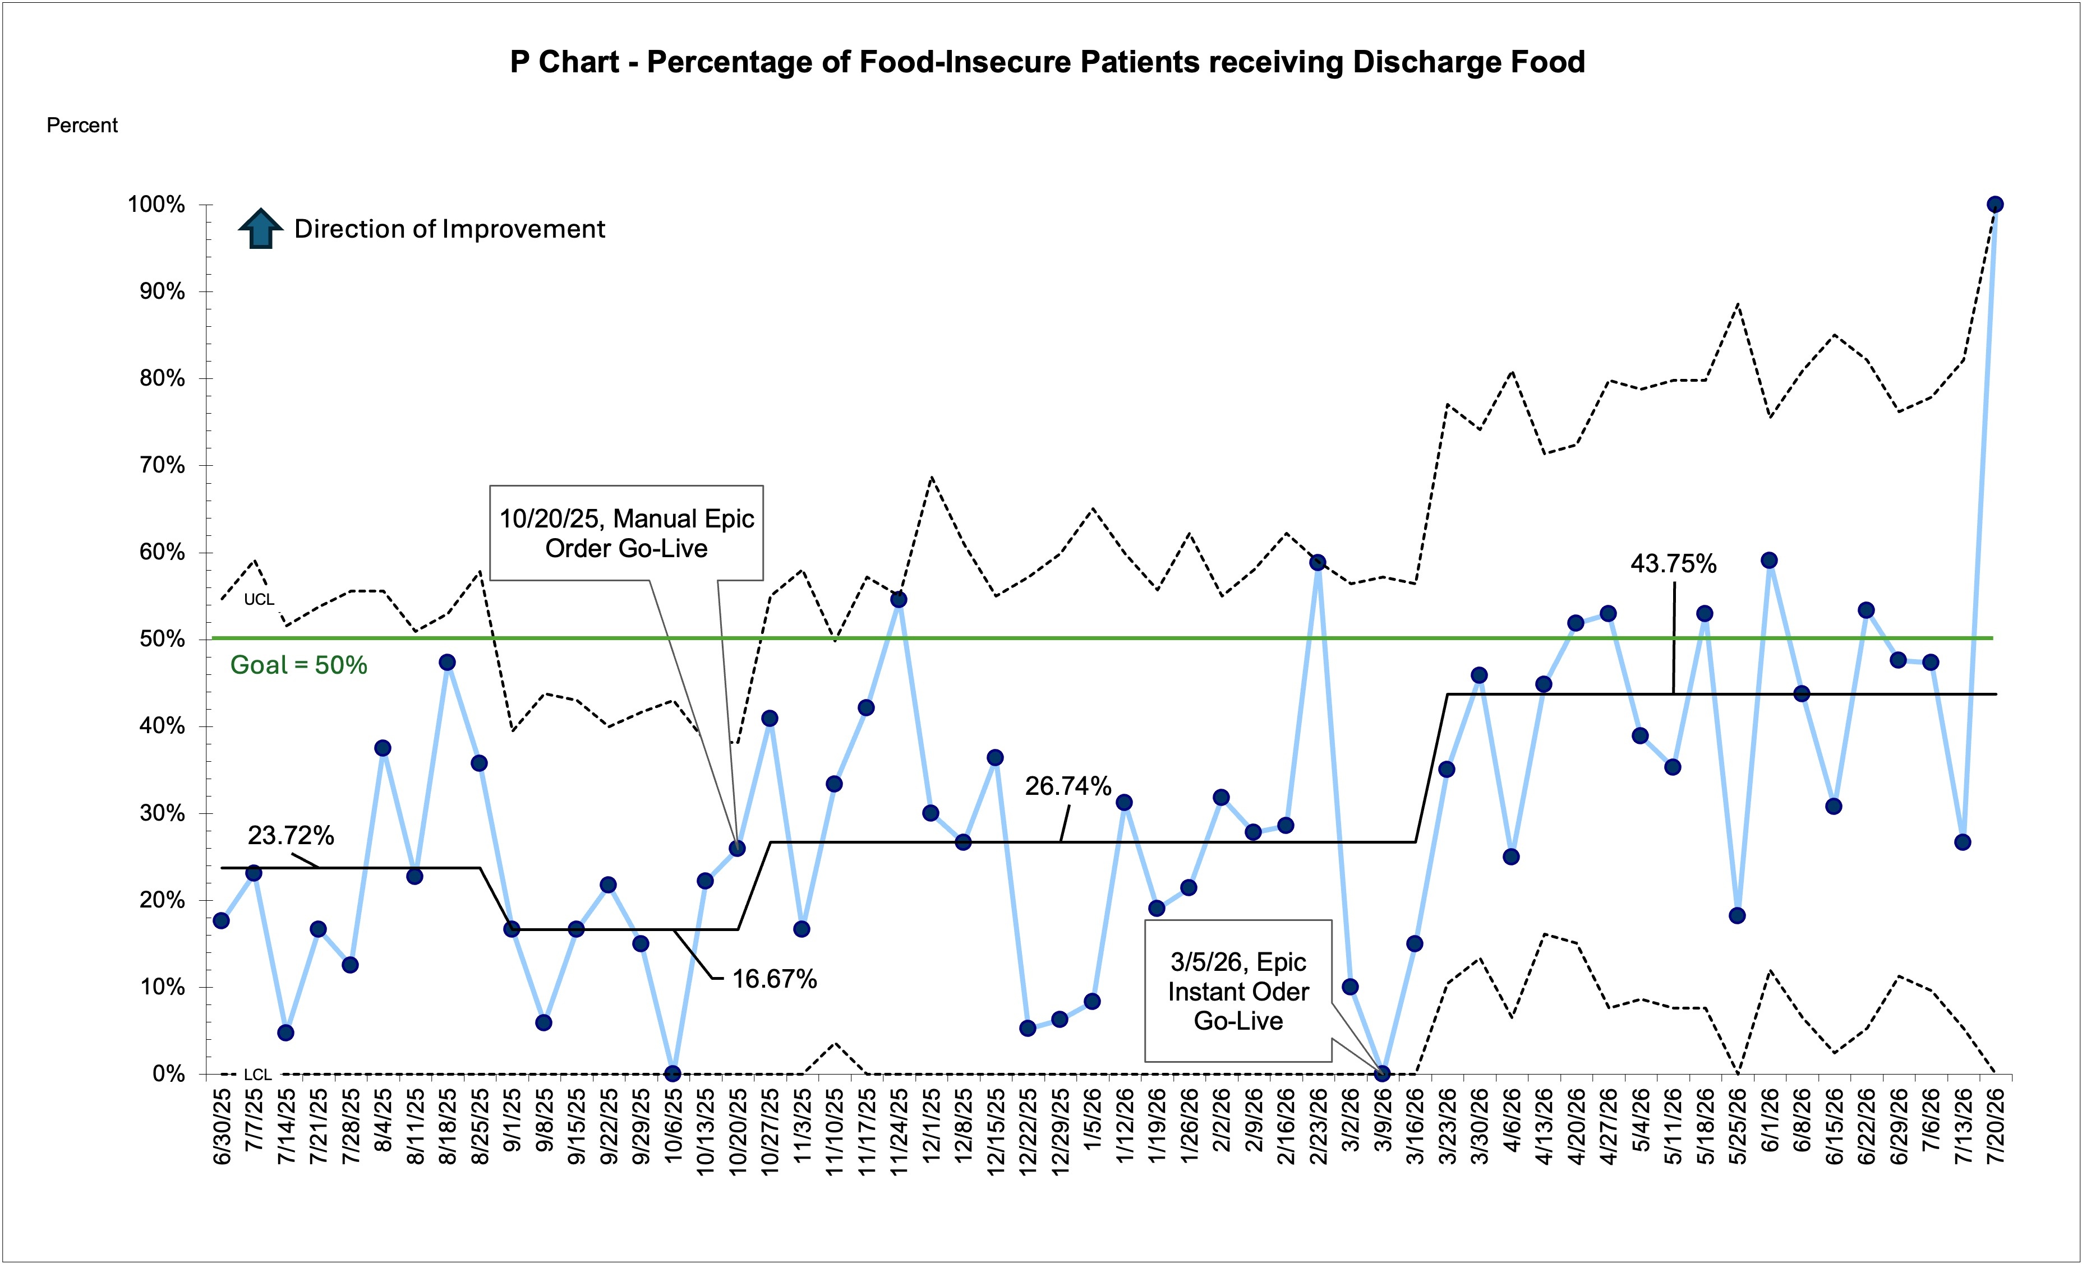

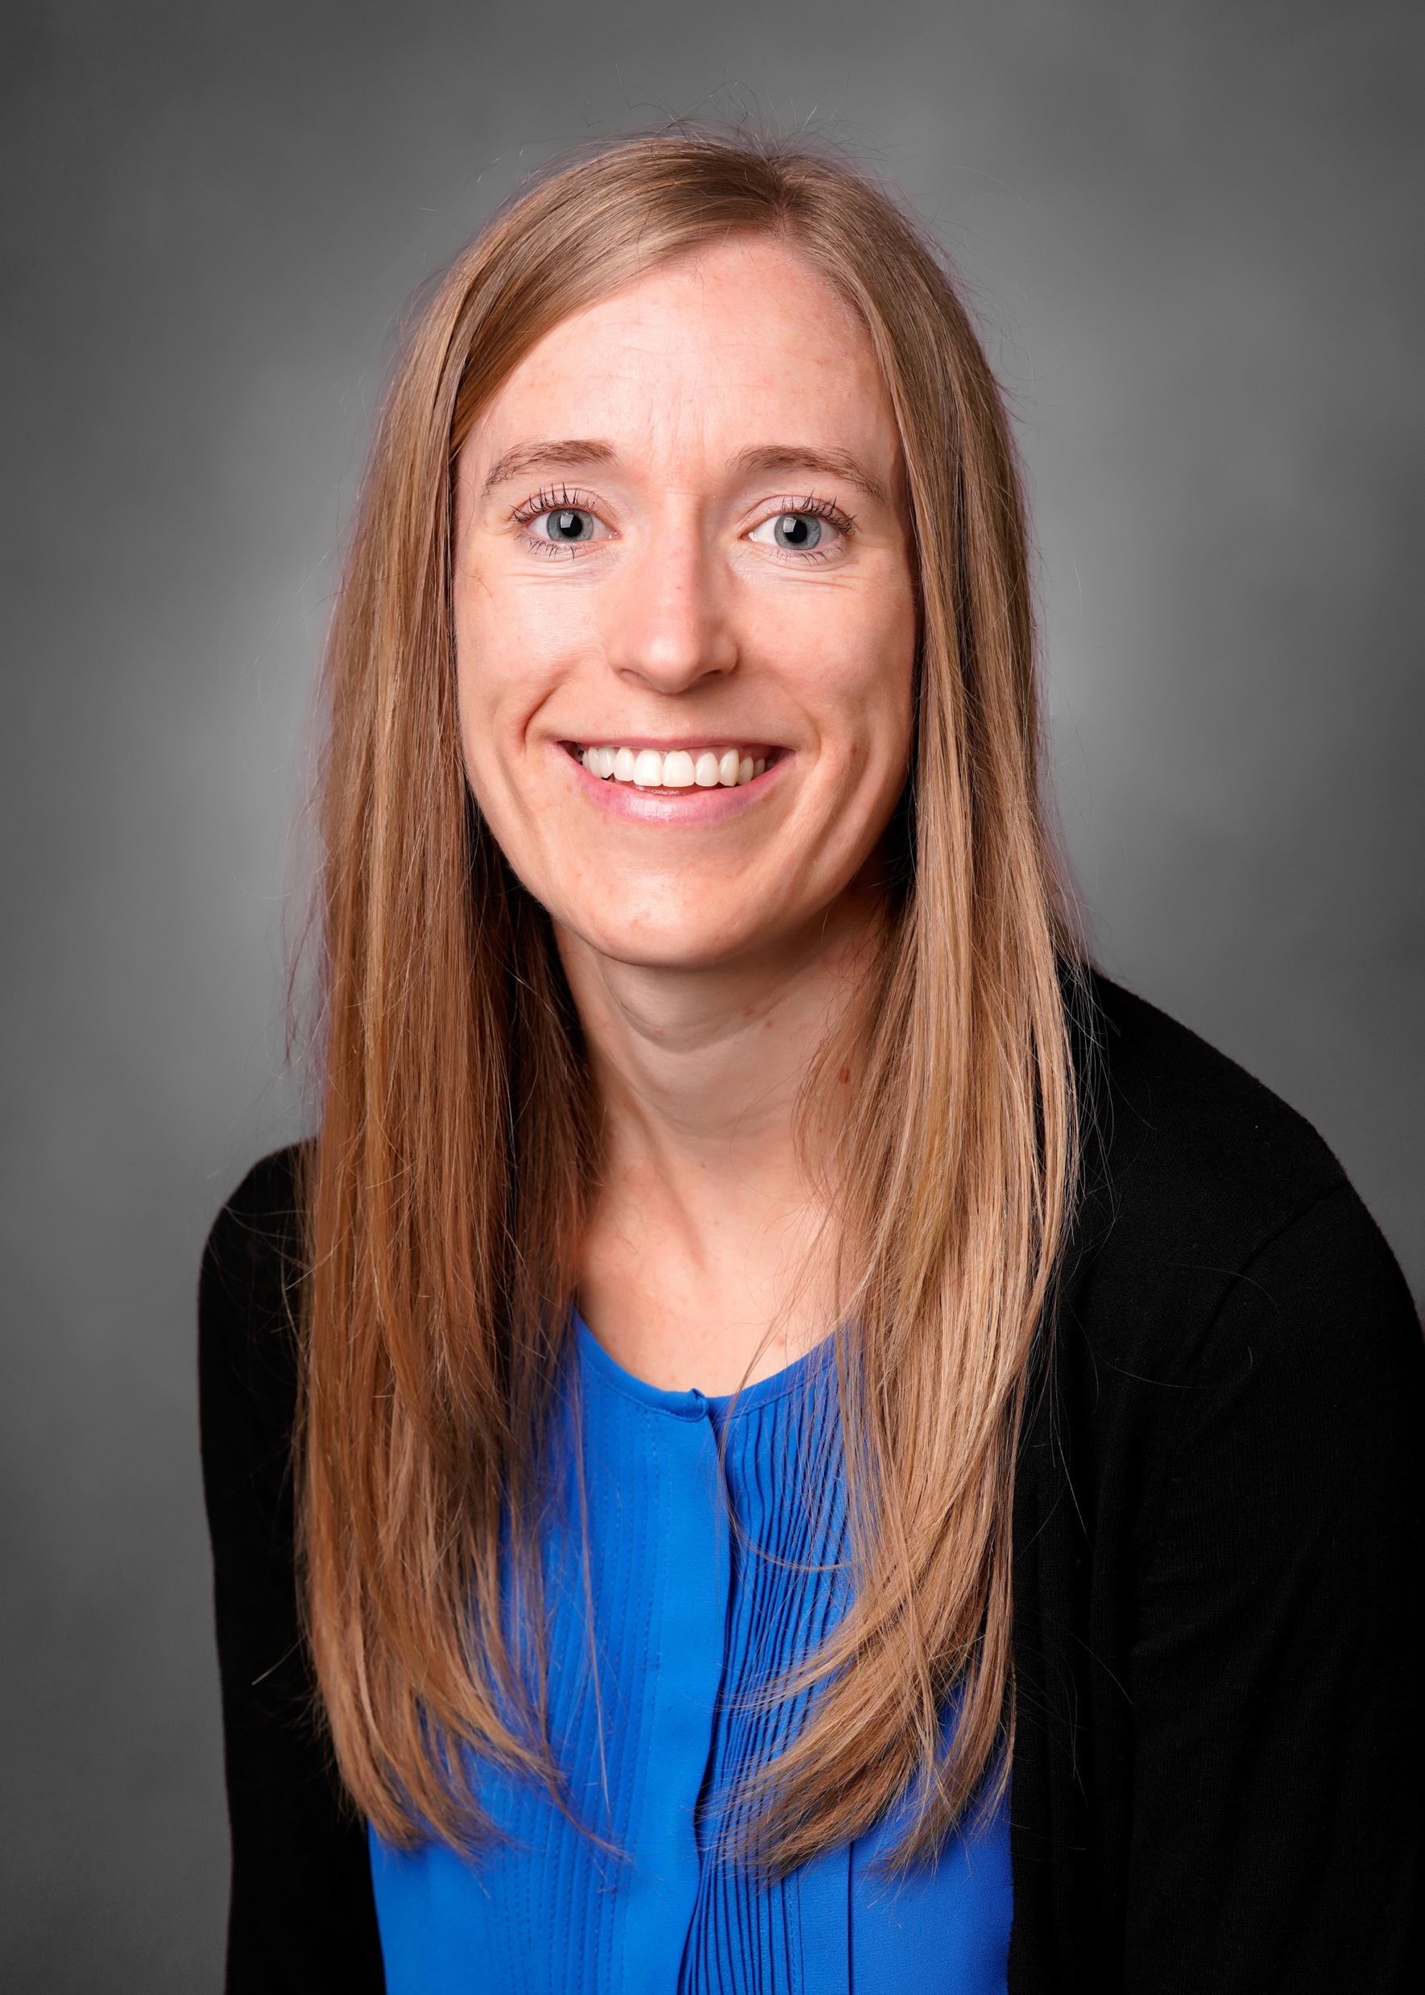


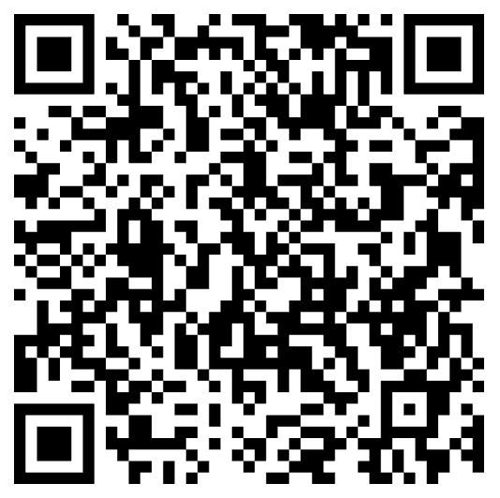
Instant Order for Discharge Food Support for Inpatients with Food Insecurity
Stephanie Patterson MD, MS; Mert Sekmen MS; Brianna Lillwitz BS; Sara Hanai MSPT; Dawn Goretske-Holecek; Randy Winstead MSN, RN; Wael Alrifai MD, MS; Cristin Fritz MD, MPH
Department of Pediatrics, Vanderbilt University Medical Center
Background
About 10% of families at Monroe Carell Jr. Children’s Hospital at Vanderbilt experience food insecurity (FI)
We created an EHR-automated order to increase the number of families with FI receiving a discharge food box
METHODS
RESULTS
Creating a manual EHR order for a discharge food box increased families receiving food by 10% (16% to 26%)
Instant EHR order increased discharge food distribution twofold with 43% of families receiving discharge food
Since instant order go live (3/5/26) 99.4% of families identified with FI have received order for the discharge food support, a fourfold increase in order being placed
Tracked balancing measure with zero auto-orders for patients without identified FI
Instant Order for Discharge Food Support for Inpatients with Food Insecurity.pdf
Health Informatics for Addressing Health-Related Social Needs: Food Insecurity
EHR instant orders can help healthcare systems address health-related social needs such as food insecurity
Using an instant order ensured nearly all eligible families experiencing FI received an order for discharge food support
EHR-based process automation can optimize hospital-based food assistance programs
Implementation and incorporation of food resources into the EHR allow for improved reach and data analysis of food programs
Limitations of food distribution still exist with families being unaware or unable to pick-up food
EHR instant order increased food distribution twofold for families with food insecurity, with 43% of families receiving discharge food
Nearly all families with food insecurity now have an order for discharge food
EHR instant order allows team to distribute more food
Presenter:
Dr. Stephanie Patterson MD, MS
Stephanie.g.patterson@vumc.org
Scan for full text
Notes:
Notes:
In Powerpoint, click View > Guides
Keep text within gutter guides.
Author list: Don’t split names onto two lines (e.g., “Jimmy [break] Smith”). If that happens, use a new line, unless you need the space. Bold the first names of anybody who’s presenting in person.
Intro/methods/result: Do not drop below font size 28, but if you have extra space, jack up the font size until the space is full.
Do not use color in the sidebars except in graphs/figures. It’ll pull attention from the center and slow interpretation for passersby.

