Slide 1
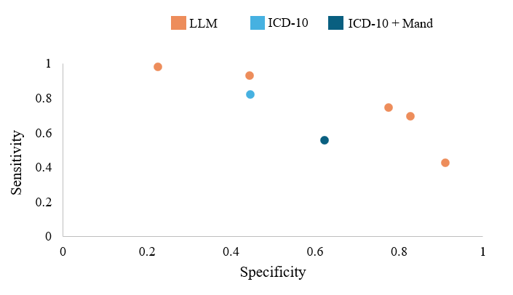
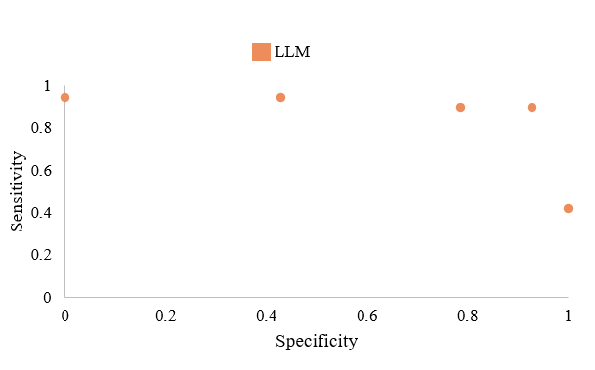
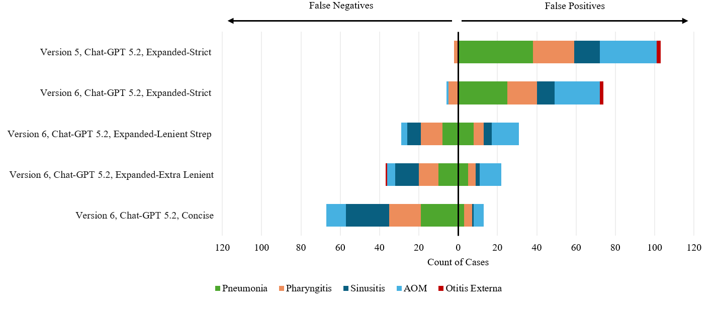

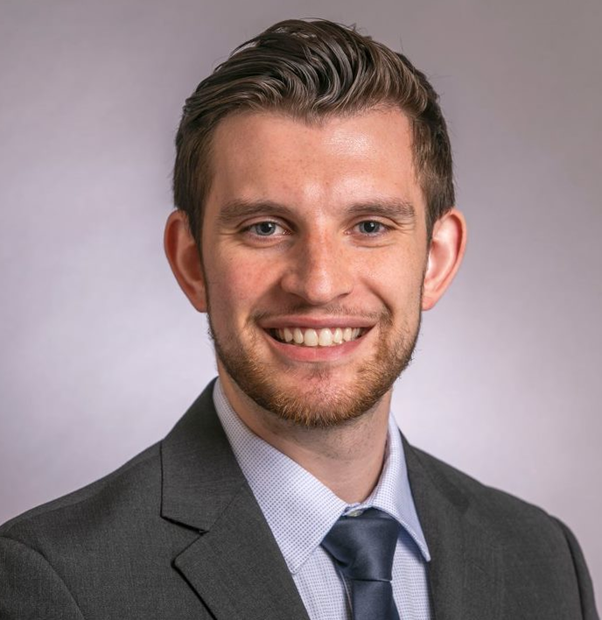


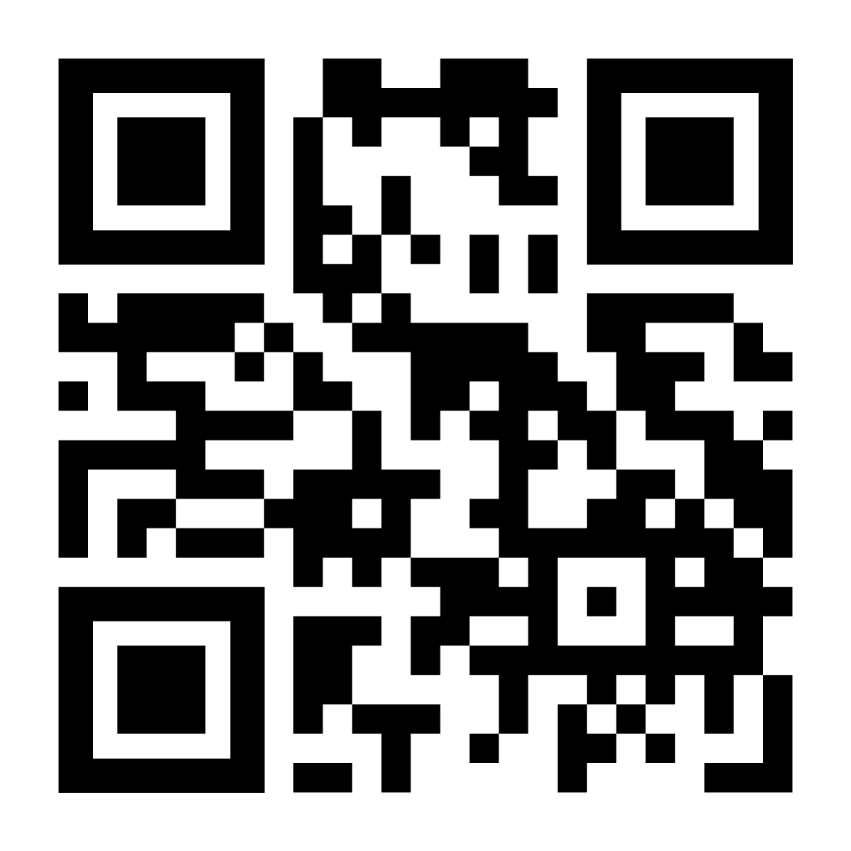

Large Language Models as a Scalable Alternative to Chart Review for Antibiotic Stewardship Audit of Emergency Department Upper Respiratory Infections
Jordano, JO^{1,2}, Mora BL³, Wrenn JO^{1,2,4}, Han JH^{1,2}, Staub M³, Ward MJ^{1,2,4}, Vanderbilt Emergency Medicine Residency Class of 2028¹
1: Department of Emergency Medicine, Vanderbilt Health; 2: Geriatric Research, Education, and Clinical Center, VA Tennessee Valley Healthcare System; 3: Department of Medicine, Division of Infectious Diseases, Vanderbilt Health; 4: Department of Biomedical Informatics, Vanderbilt Health
PURPOSE
Unnecessary antibiotic prescription contributes to harm.
Upper respiratory infections (URIs) are a common source of unnecessary antibiotics.
Chart review is the gold standard for prescription audit, but it is slow and laborious.
Diagnosis codes are faster but inaccurate.
Can large language models be both accurate and efficient?
METHODS
Chat-GPT 5.2 outperformed diagnosis codes in antibiotic audit of ED upper respiratory infections
 | Training Dataset | Validation Dataset
Sample Size | 325 | 65
Female no. (%) | 207 (63.7%) | 44 (67.7%)
Non-White no. (%) | 99 (30.5%) | 15 (23.1%)
Age median (IQR) | 37 (27,52) | 40 (29, 59)
Charlson Comorbidity Index median (IQR) | 0 (0, 2) | 0 (0, 2)
Hosp: Academic no. (%) | 128 (39.4%) | 20 (30.8%)
URI Only no. (%) | 252 (77.5%) | 50 (76.9%)
Testing Cohort (n=325)
Validation Cohort (n=65)
Table 1. Descriptive Demographics of Training and Validation Datasets. Data are displayed as percentage (number) or median (25th, 75th percentile). URI: Upper respiratory infection. Hosp: Academic refers to the academic hospital compared to the regional affiliated hospitals, IQR: Interquartile range
Population: Patients age ≥18 years old, with a URI diagnosis code, discharged from one of four emergency departments with antibiotics in 2024
Study Design: Retrospective observational cohort study
Gold Standard—Chart review: Each chart reviewed by two blinded emergency medicine residents, with adjudication by infectious diseases physicians
Diagnosis Codes +/- Mandatory Indications: Reviewed for antibiotic inappropriateness by an emergency medicine resident with support from infectious diseases physicians
Large Language Model: Prompt engineering with OpenAI models, mainly Chat-GPT 5.2. Followed by prompt validation cohort, missed diagnosis review, and time assessment
Figure 1. Performance Results from Large Language Model Prompts Compared to ICD-10 Codes and ICD-10 Codes and Mandatory Indications. Each final prompt is represented as an orange dot, reflecting its individual specificity and sensitivity. ICD-10 and ICD-10 + Mandatory Indications (ICD-10 + Mand) are shown in light blue and navy blue, respectively, on the figure for performance comparison.
Figure 2. Performance Results from Large Language Model Prompts on the Validation Dataset. Each final prompt is represented as an orange dot, reflecting its individual specificity and sensitivity.
Figure 2. Inappropriately Identified or Treated Conditions by Large Language Model Prompt. Each color represents a different condition. X-axis represents the number of cases with that condition for each prompt. False negatives are cases in which the large language model (LLM) wrongly said antibiotics were appropriate (false negative). False positives are cases in which the LLM wrongly said antibiotics were inappropriate (false positive). AOM = Acute Otitis Media
Method | # Charts in Total Time | Estimated Time per Chart | Estimated FTE for 1000 Charts
Chart Review | 17 Charts, 85 Minutes | 5 Minutes | 2.08
ICD-10 | 65 Charts, 12 Minutes | 11.4 Seconds | 0.078
LLM | 65 Charts, 3 Minutes | 2.76 Seconds | 0.019
Table 2. Time Estimate for Each Audit Method. The time to complete a set number of charts was measured, rounded to the nearest minute. The time per chart was assumed to be equal within each audit method. Full-Time Equivalents (FTE) were assumed to be 40 hours per week. ICD-10: International Classification of Diseases, 10th revision. LLM: Large Language Model
Presenter:
James O. Jordano, MD
James.Jordano@vumc.org
Scan for full text
Emergency Medicine
Notes:
Notes:
In Powerpoint, click View > Guides
Keep text within gutter guides.
Author list: Don’t split names onto two lines (e.g., “Jimmy [break] Smith”). If that happens, use a new line, unless you need the space. Bold the first names of anybody who’s presenting in person.
Intro/methods/result: Do not drop below font size 28, but if you have extra space, jack up the font size until the space is full.
Do not use color in the sidebars except in graphs/figures. It’ll pull attention from the center and slow interpretation for passersby.

