Slide 1
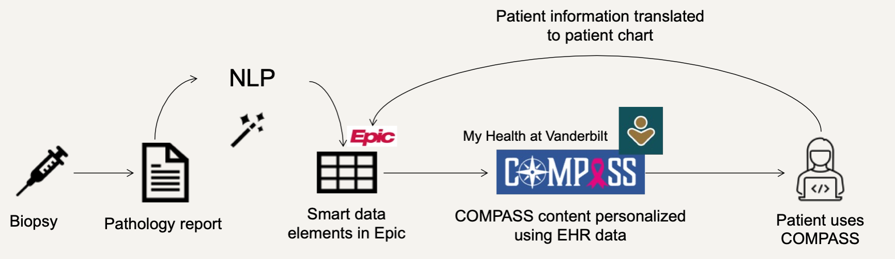

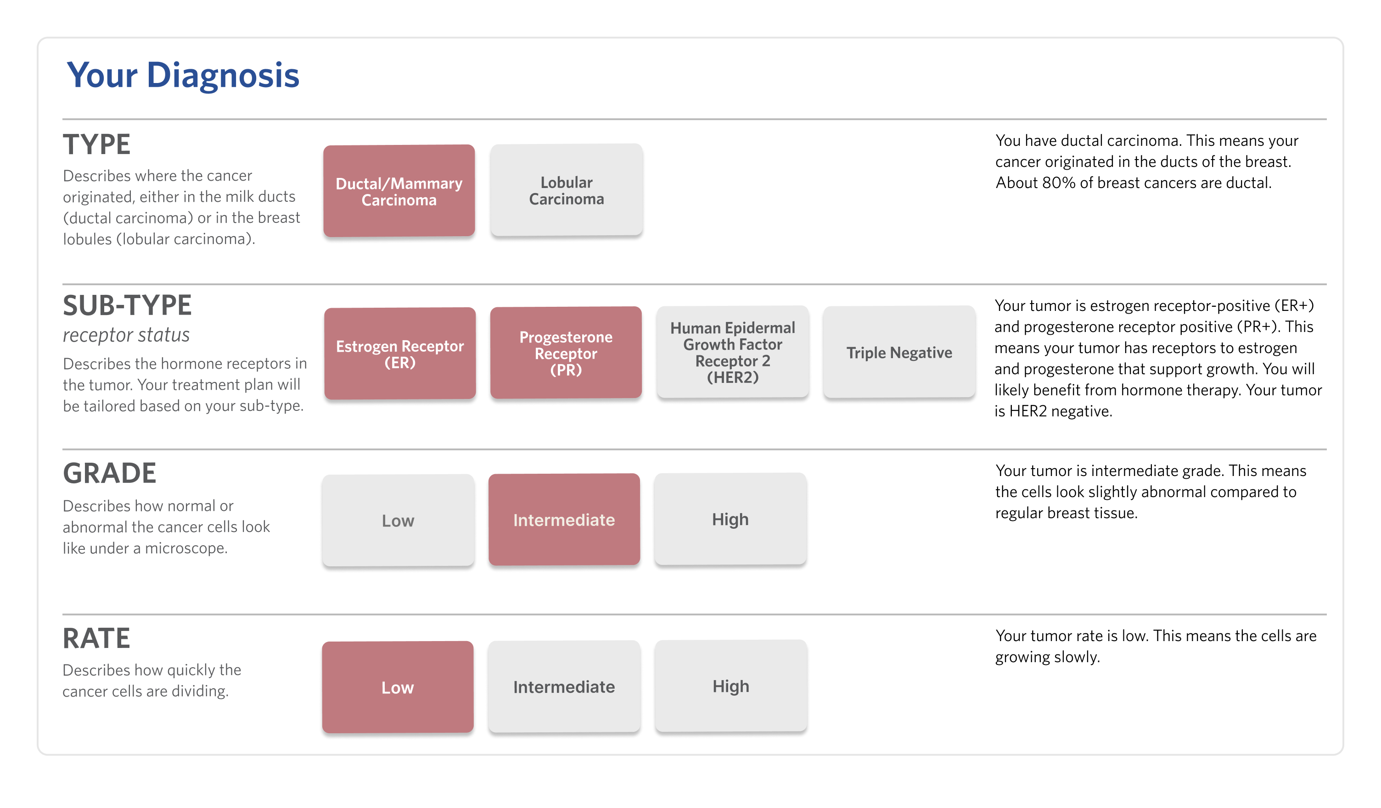
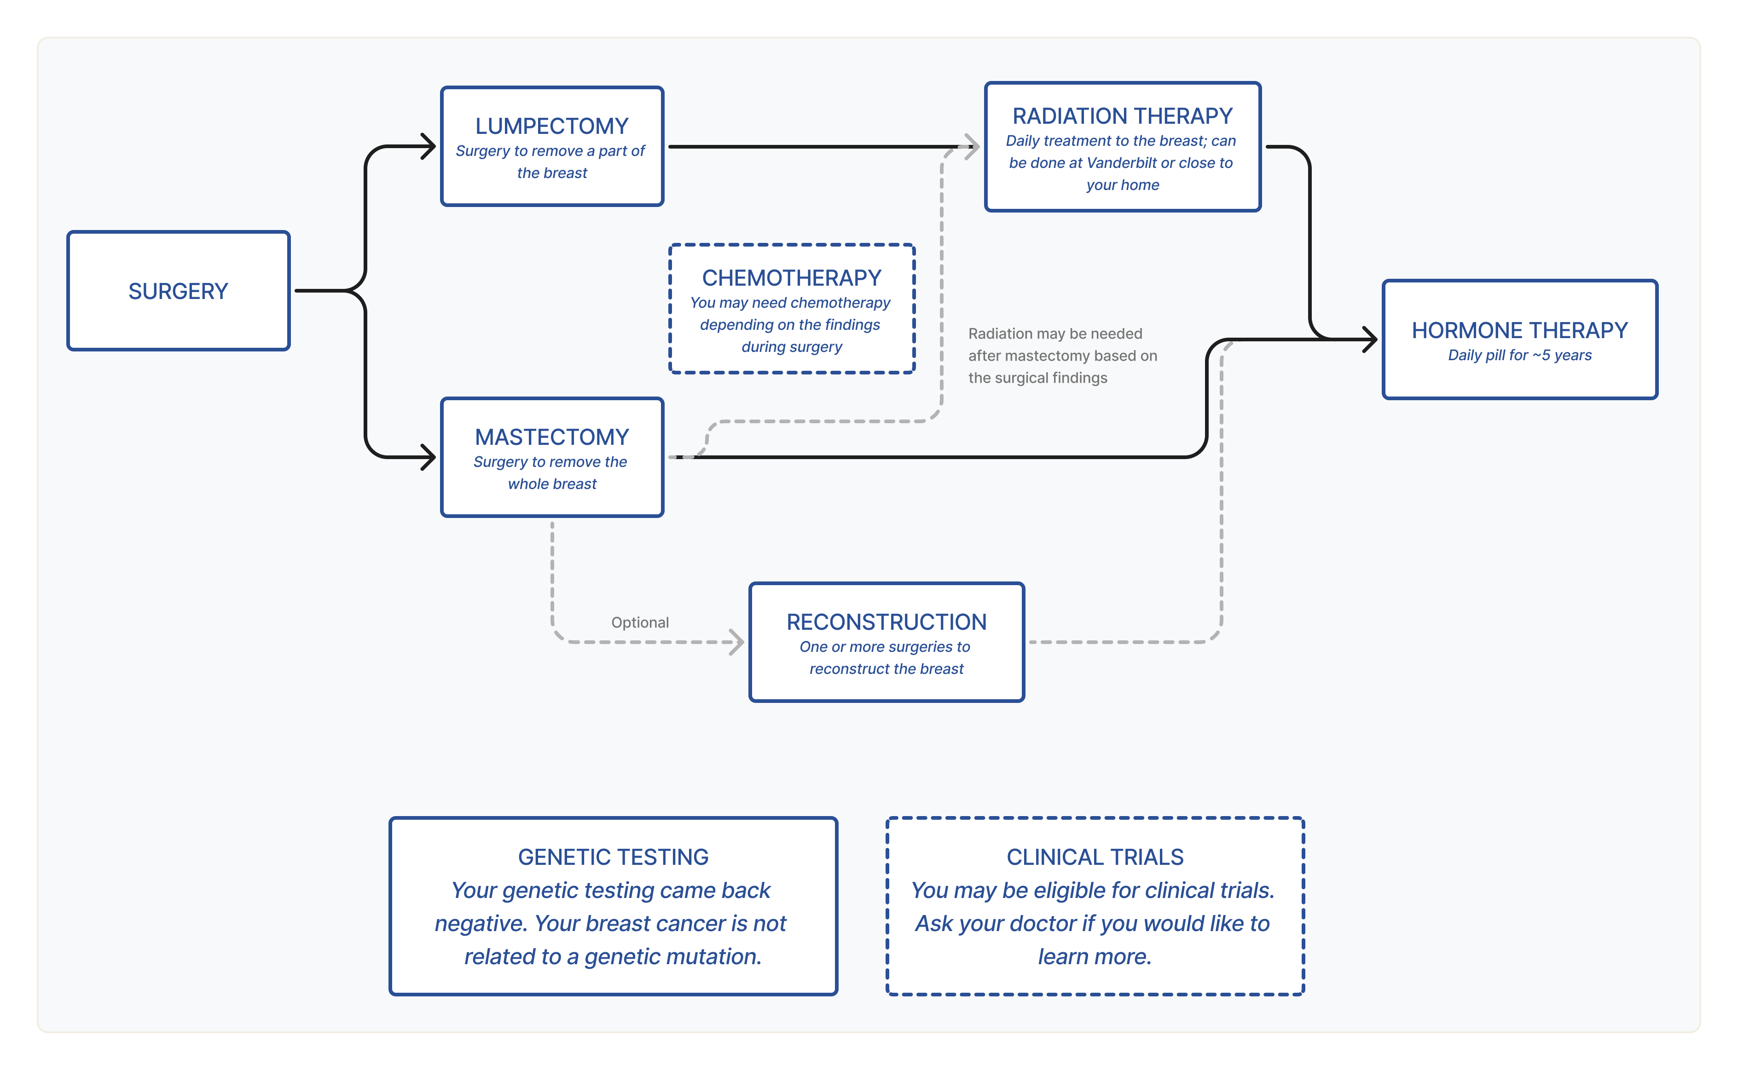

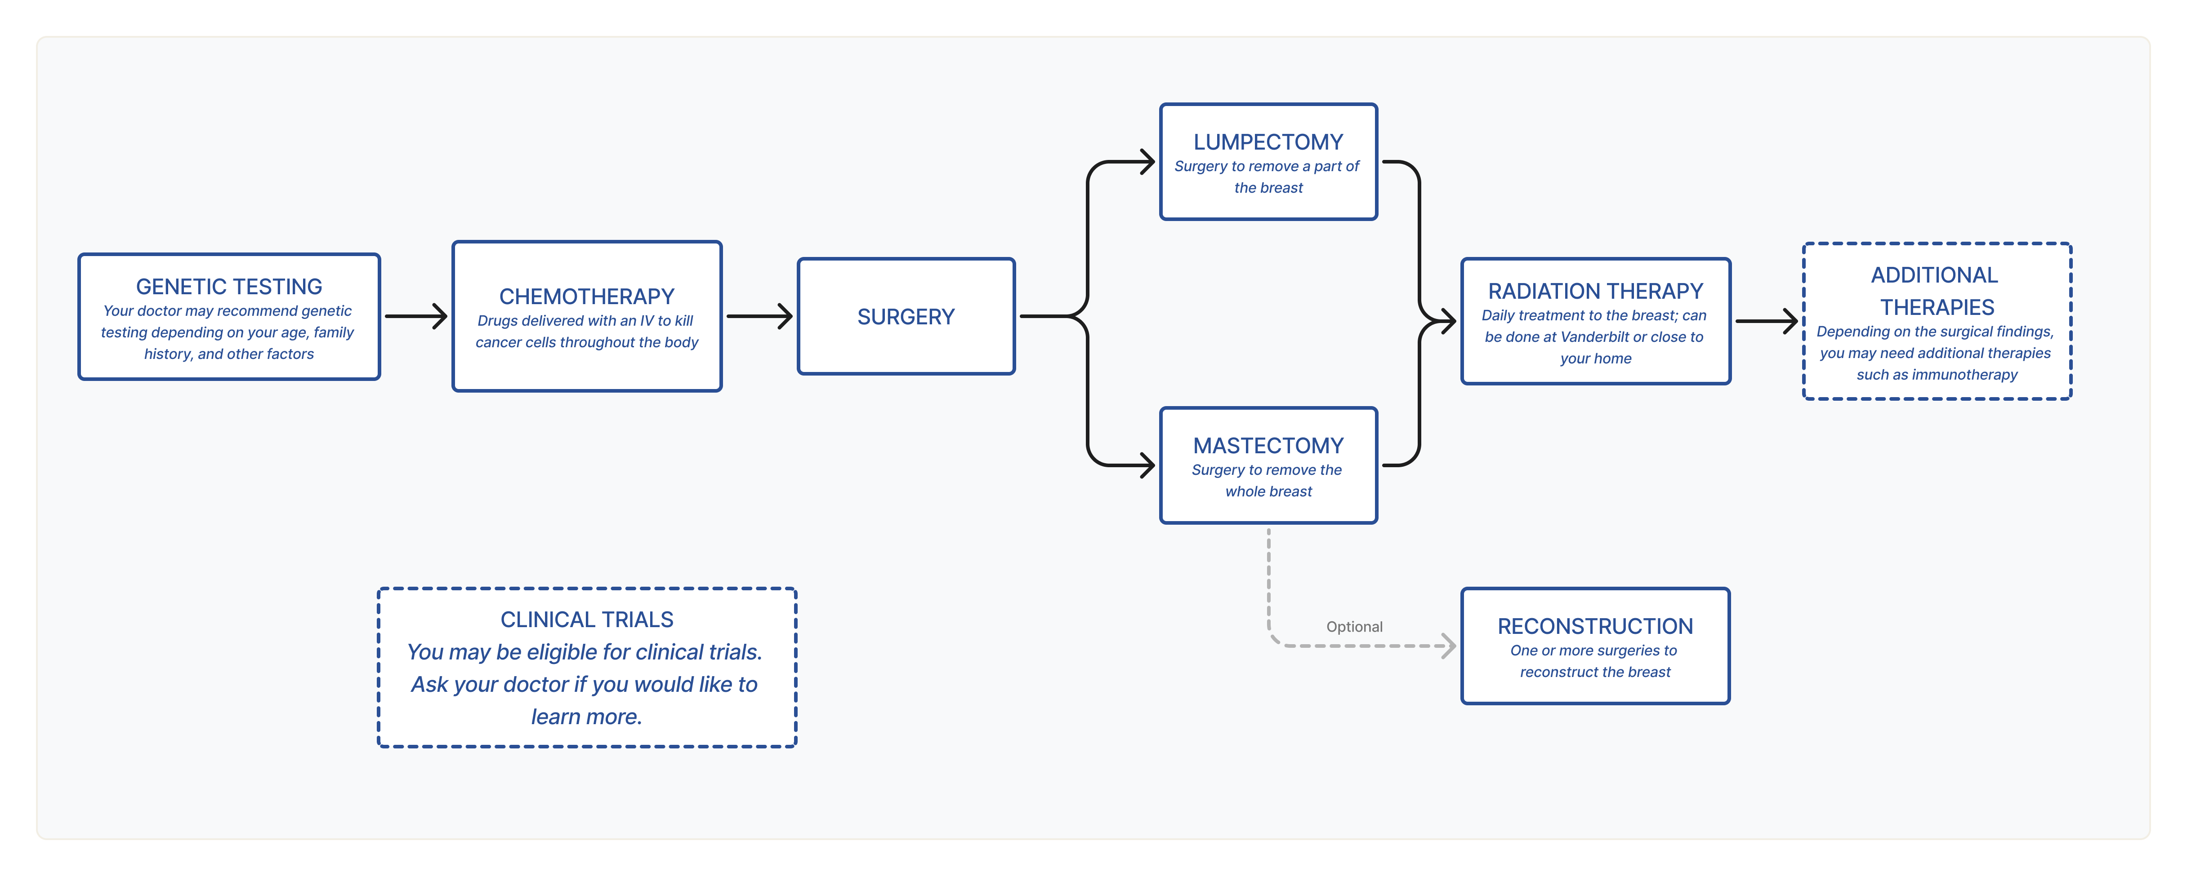


Improving personalized breast cancer care through a COMputerized Patient Adaptable Shared decision-making System (COMPASS)
Megan E. Salwei, PhD, Ryan Myles, BA, Carrie Reale, MSN, RN, NI-BC, Janelle Faiman, BA, Allison McCoy, PhD, Matthew Weinger, MD
Center for Research and Innovation in Systems Science (CRISS)
BACKGROUND
Breast cancer treatment is highly individualized and requires shared decision-making
Treatment decision-making is challenging for patients and over 70% of patients experience decision regret
The COMPASS tool
Using human-centered design, we developed COMPASS, which:
  personalizes the information presented to each patient based on their diagnosis
  is integrated in the EHR and patient portal to streamline workflows
METHODS
High-fidelity clinical simulation at CELA
20 participants randomized to COMPASS or usual care
Mock discussions with surgical oncologist
COMPASS improved patient knowledge of treatment options with personalized visualizations of care pathways
RESULTS
High usability - average SUS score of 92/100
High usefulness and acceptance by breast cancer patients
COMPASS increased knowledge about treatment options
NEXT STEPS
RCT to evaluate COMPASS with real patients
Personalized treatment journeys
Presenter:
Megan Salwei
Megan.Salwei@vumc.org
Personalized pathology report
Notes:
Notes:
In Powerpoint, click View > Guides
Keep text within gutter guides.
Author list: Don’t split names onto two lines (e.g., “Jimmy [break] Smith”). If that happens, use a new line, unless you need the space. Bold the first names of anybody who’s presenting in person.
Intro/methods/result: Do not drop below font size 28, but if you have extra space, jack up the font size until the space is full.
Do not use color in the sidebars except in graphs/figures. It’ll pull attention from the center and slow interpretation for passersby.

