Slide 1
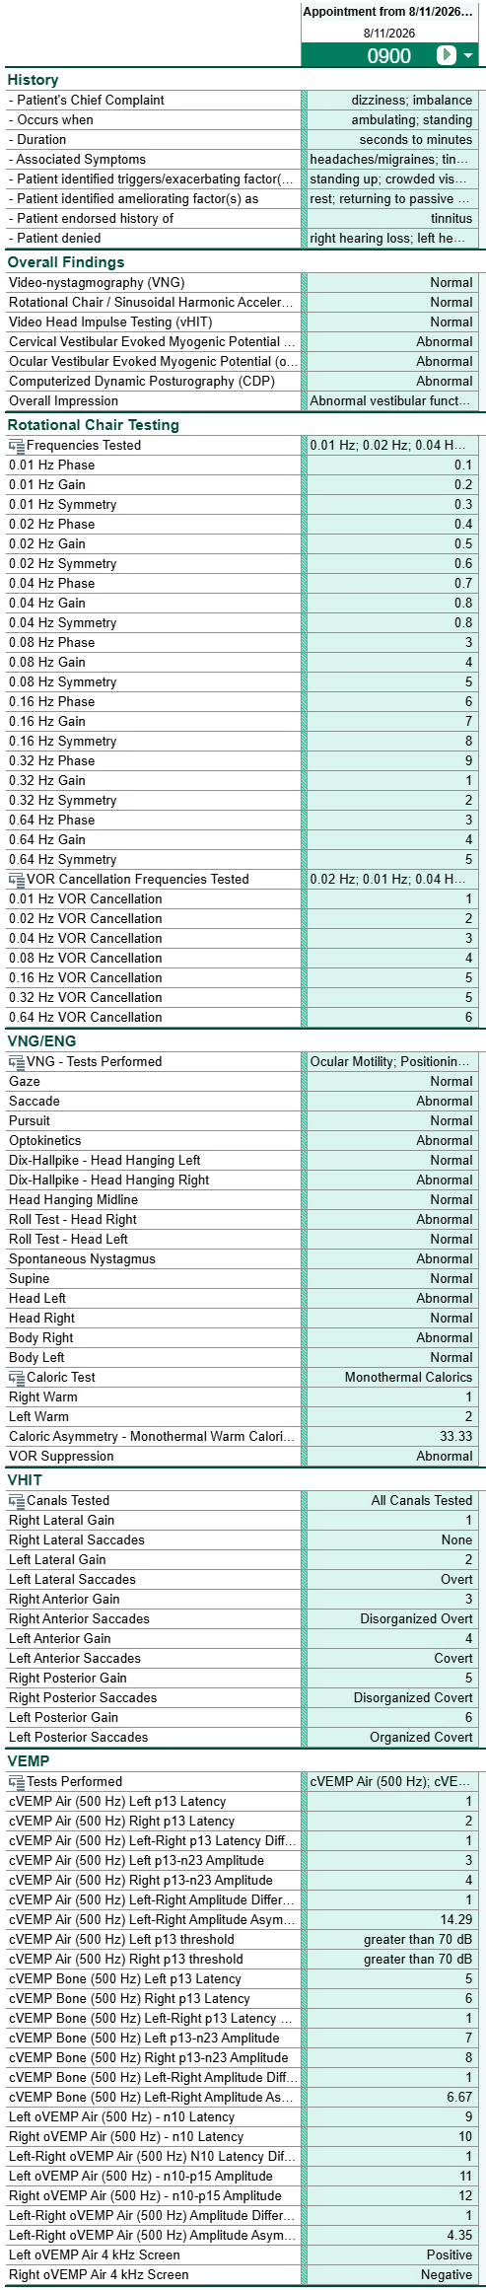
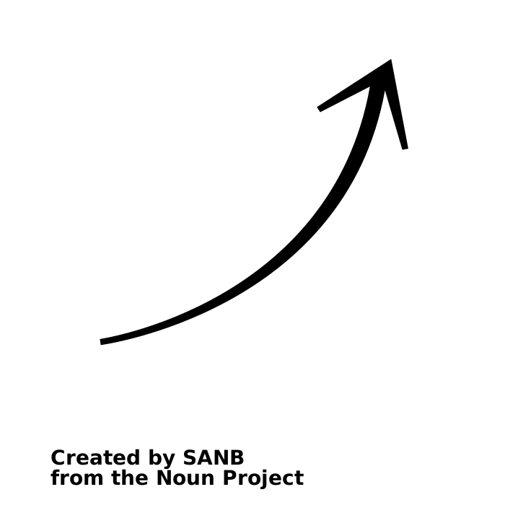
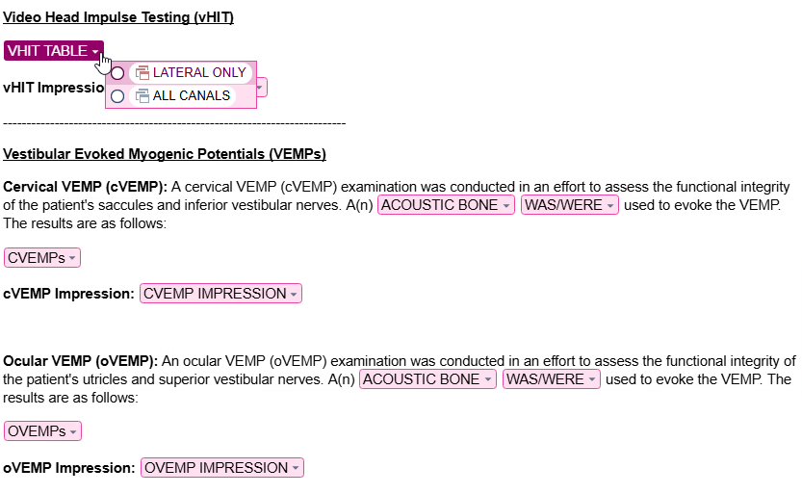
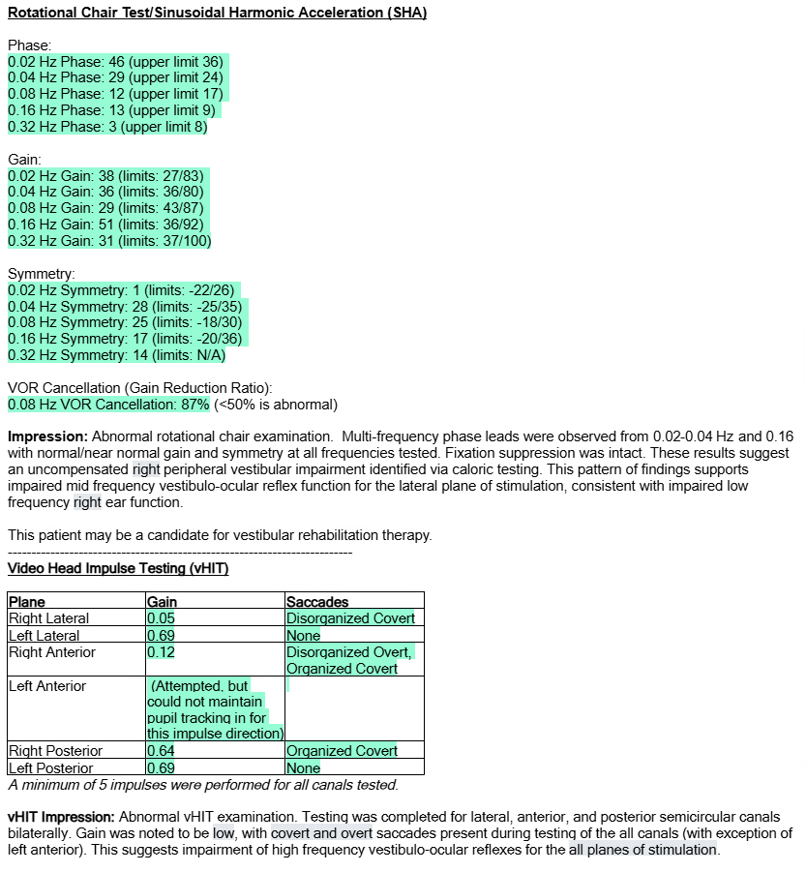
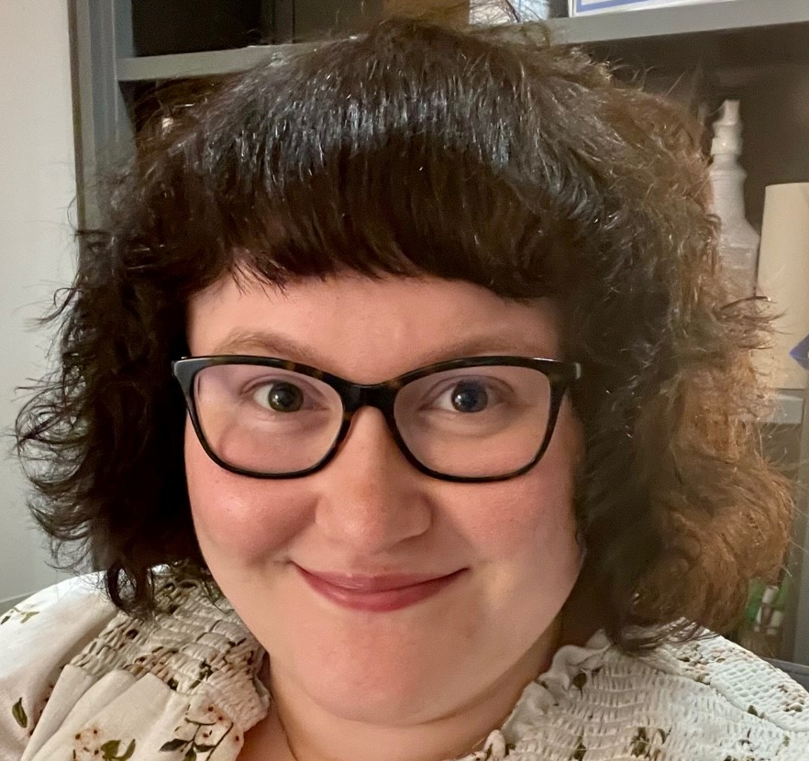


Streamlining Vestibular Audiology Documentation in eStar
Kelly Fussman, MS, CCC-SLP
Vanderbilt University Medical Center – HealthIT
BACKGROUND
Through the Physician Builder / Clinical Content Builder program, trained members can customize and configure our local instance of Epic to improve clinical workflows.
Vestibular audiologists historically have an elevated Pajama Time metric due to documentation burden.
PURPOSE
Streamline vestibular audiologists’ documentation workflow to improve efficiency while simultaneously capturing robust data for research.
METHODS
= 8 audiologists
survey + Signal data
Audiologists report increased satisfaction and efficiency with their updated, streamlined
documentation workflow.
OUTCOMES
Pajama Time (hours/month)
Perceived Documentation Time Per Appt (mins)
Self-Reported Satisfaction (0-10)
Anecdote
“The revamp removed tedious steps, removed duplicative steps, and it is overall very positive.“
May 2026 | July 2026
3.0 | 2.4
Note Template
Pre-Revamp | Post-Revamp
21.7 | 9.7
Pre-Revamp | Post-Revamp
2.7 | 9.7
Presenter: Kelly Fussman
kelly.fussman@vumc.org
Flowsheet
HealthIT
Notes:
Notes:
In Powerpoint, click View > Guides
Keep text within gutter guides.
Author list: Don’t split names onto two lines (e.g., “Jimmy [break] Smith”). If that happens, use a new line, unless you need the space. Bold the first names of anybody who’s presenting in person.
Intro/methods/result: Do not drop below font size 28, but if you have extra space, jack up the font size until the space is full.
Do not use color in the sidebars except in graphs/figures. It’ll pull attention from the center and slow interpretation for passersby.

