Slide 1
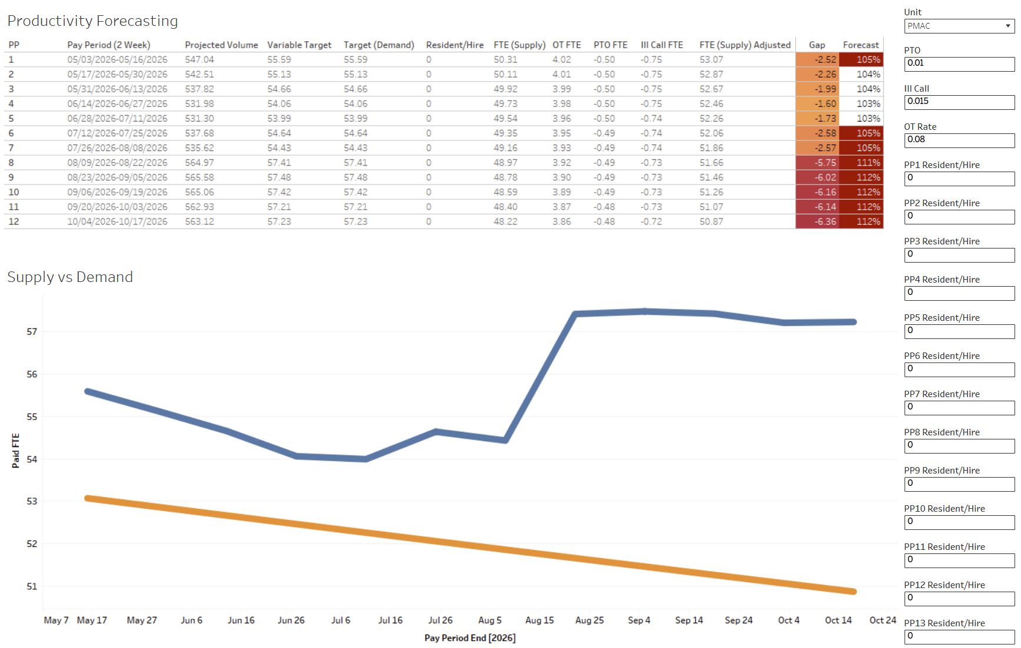



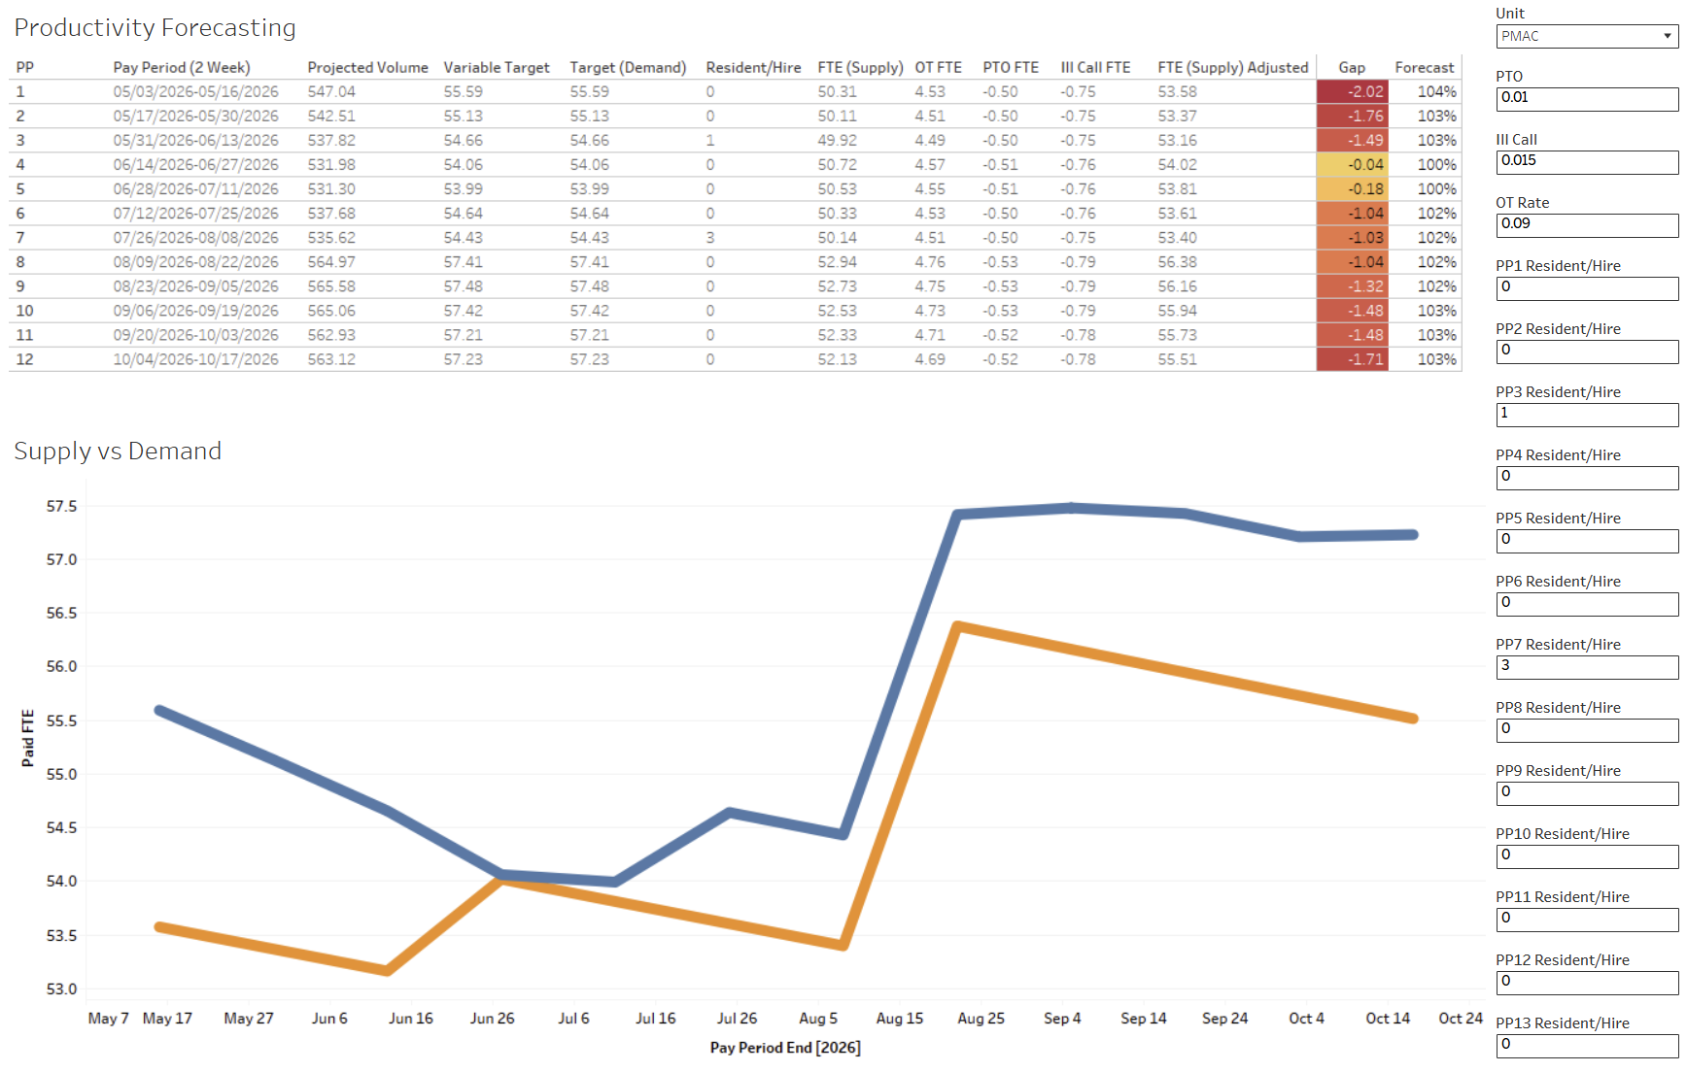



Future Labor Productivity: Developing a Workforce Planning Tool to Predict Staffing Outcomes and Manage Future Staffing Demands
Zachary Melvin, MS; Pradeep Mummidi, MS, MMHC; Wael Alrifai, MD, MS; Morgan Wright, MBA
Peds Analytics, Monroe Carrell Jr. Children’s Hospital at Vanderbilt
BACKGROUND
Healthcare organizations often make staffing decisions using current census and historical trends, limiting their ability to proactively prepare changes in patient demand. We wanted to create of proof-of-concept method to explore the feasibility of projecting these staffing decisions months in advance. To do this we developed a tool that would calculate future demand compared to staffing availability that can enable more proactive workforce planning, improve labor productivity, and better align staffing resources with expected patient volume.
INPUTS
Future patient demands (Monte Carlo/Regression model)
RN only Human Productivity Unit (HPU) targets (MCC Finance team)
Current staffing snapshot (Workday FTE)
Retention rate (historical trends)
Overtime FTE (short term trends/SME input)
Paid Time Off (SME input)
Ill Call (SME input)
A predictive workforce planning tool for leaders to transform these inputs into actionable decisions before challenges arise.
OUTCOMES
Inputs along the right-hand side of the report act as inputs for staffing leaders to use in their decision-making process.
Customizable inputs allow leadership to better allocate resources over the next six months.
Future patient demands project an increased census in August (beginning of school year). This results in 112% productivity rate with current staffing by end of August.
Increasing OT by 1% and timing resident/new hire nurse entry dates, 1 FTE in PP3 and 3 FTE in PP7, will allow the unit to stay within the 105% productivity rate target.
May-Oct 2026 Snapshot (Before Decisions)
Report Definitions:
PP - Pay Period order
Pay Period (2 Week) - Start and end date for the pay period
Projected Volume - Projected total midnight census volume (VCH Analytics model)
Variable Target - Target FTEs calculated using each units HPU
Target (Demand) - Variable Target FTEs adjusted with unit Fixed FTE
Resident/Hire - New resident/hire FTEs starting for the pay period, entered by user
FTE (Supply) - The units available FTE for each pay period, adjusted for staff retention and resident/new hire starts
Gap -Difference of Target (Demand) and FTE (Supply), highlights gap in FTE for upcoming pay periods
Forecast - Target (Demand) divided by FTE (Supply), a higher percentage indicates an understaffed unit, a lower percentage indicates an overstaffed unit
Presenter:
Zachary Melvin
May-Oct 2026 Snapshot (After Decisions)
zachary.melvin@vumc.org
Notes:
Notes:
In Powerpoint, click View > Guides
Keep text within gutter guides.
Author list: Don’t split names onto two lines (e.g., “Jimmy [break] Smith”). If that happens, use a new line, unless you need the space. Bold the first names of anybody who’s presenting in person.
Intro/methods/result: Do not drop below font size 28, but if you have extra space, jack up the font size until the space is full.
Do not use color in the sidebars except in graphs/figures. It’ll pull attention from the center and slow interpretation for passersby.

